Slide 1
Superheroes and Survival Strategies
LeadingAge Colorado - 2019
Annual Conference and Exhibition
Beth Roome
Switchback Institute
Notes:
EMPHASIZE:
Resilience can be learned and is dynamic
Simple-though Simple is not always easy
Self-Knowledge builds personal strength and resilience-Self Assessment is first and most important stage of resilience

Slide 2
What do you think of when you hear the word “resilient”?
What does a resilient organization/workforce look like?

Slide 3
Organizational Resilience
builds on the health and resiliency of its individuals and teams
Notes:
To build a resilient organization there must be early and ongoing involvement of staff from all levels and disciplines.

Slide 4
Resilience
Policy
Community
Organizational
Interpersonal
Individual
(Beliefs, Values, competencies, relationships)
Notes:
Dyad Intros: What does it mean to be a resilient individual?

Slide 5
Resilience
Policy
Community
Organizational
Interpersonal
Family
Expectations
Individual
Team
Co-workers
Trust
Notes:
Dual Dyad topic of conversation: What does it mean to be interpersonally resilient? Where is this evident?

Slide 6
Resilience
Policy
Community
Organizational
Interpersonal
Systems
Manageable Workloads
Individual
Redundancy/
Depth
Strategic Planning
Culture
Sections/Divisions
Notes:
Table Groups: What does it take to have organizational resilience?

Slide 7
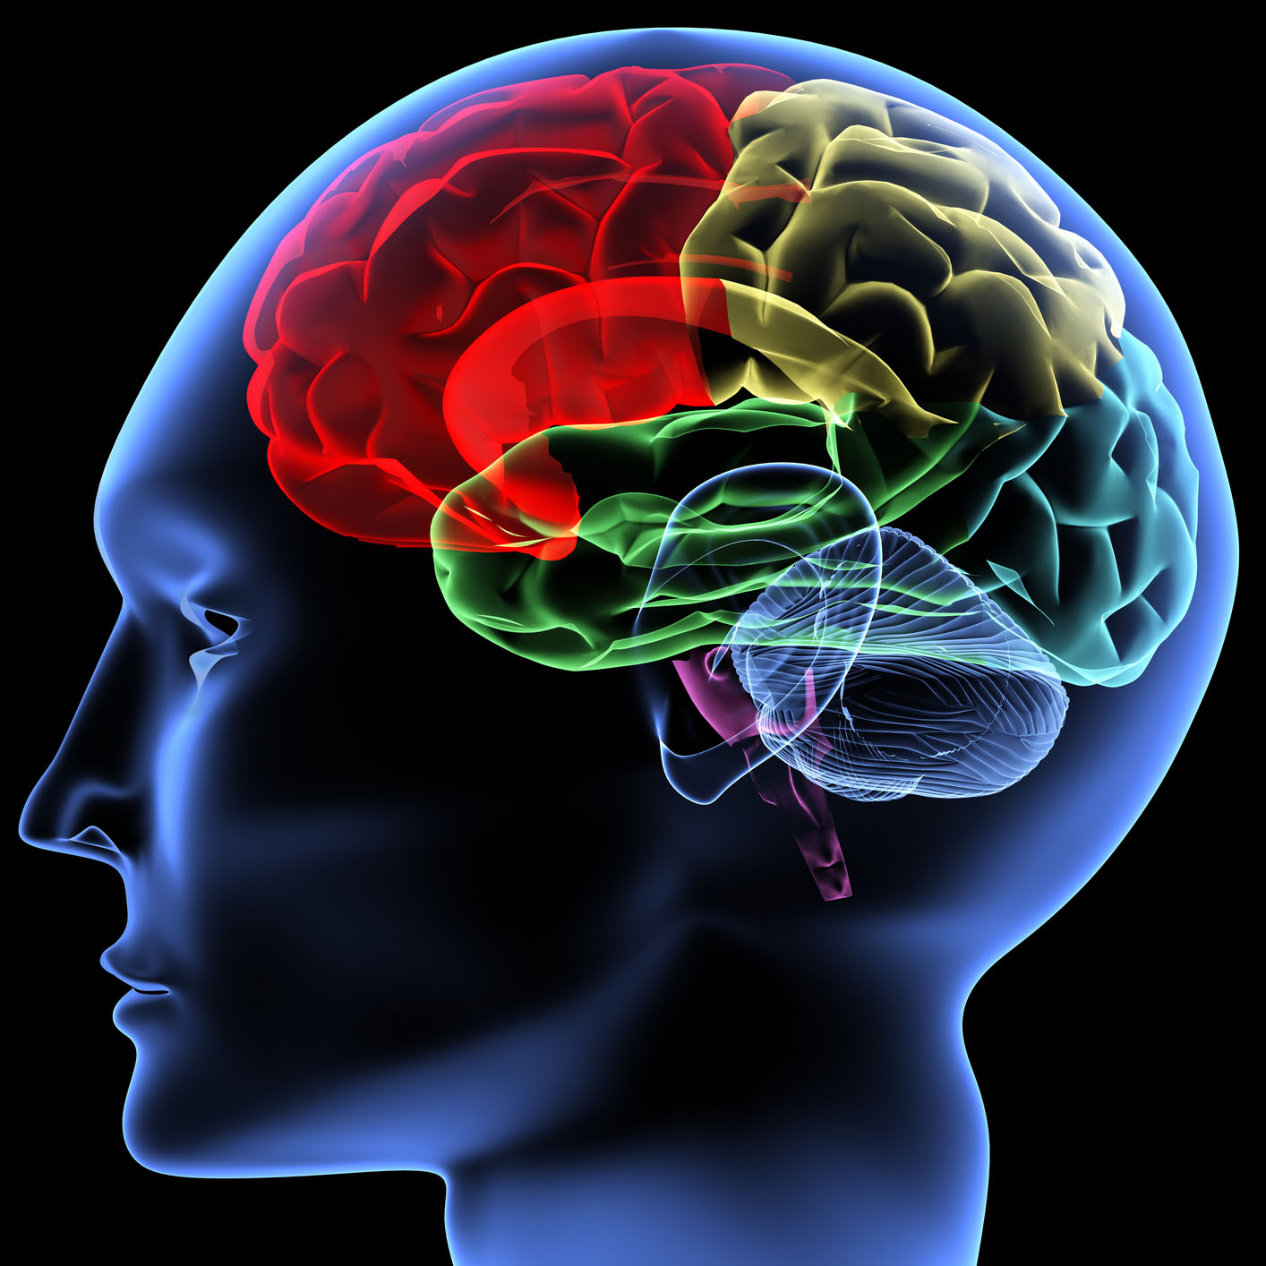

Slide 8
Black or White

Slide 9
Up or Down

Slide 10
Sweet or Sour

Slide 11
Hot or Cold

Slide 12
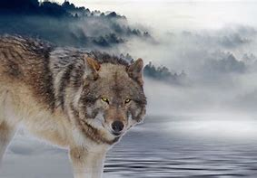
Safe or Threatening

Slide 13
Speed

Slide 14
Recall

Slide 15
Thinking Pathways
System 1 Amygdala
System 2 Cerebral Cortex
Intuitive
Fast-acting
Emotionally Charged
“Low Road”
“Bottom-up”
Fear
Pleasure
Conscious
Deliberate
Thoughtful
“High Road”
“Top Down”
Process
Movement

Slide 16
Perfection is Attainable
Myth #1
Notes:
Perfectionism increased rigid thinking

Slide 17
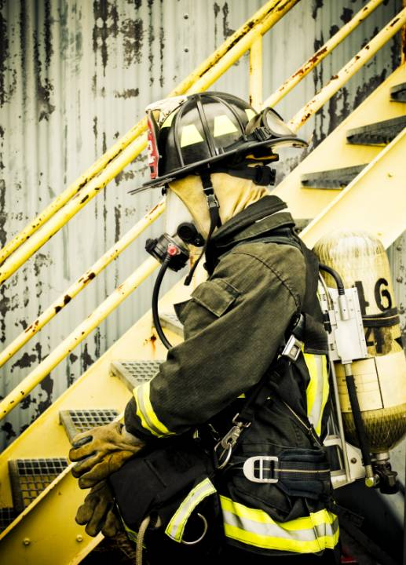
Self-care is selfish.
Myth #2
Notes:
Put your mask on before attempting to assist others.
We cannot effectively help others if we do not take care of ourselves.

Slide 18
Emotions = Weakness
Myth #3
Notes:
We actually are more vulnerable when we try to avoid our emotions
“I can’t tolerate ‘uncomfortable’ feelings
“I can witness anything and not be impacted”
Emotions exist because…
They are necessary tools for survival
They provide rapid messages to us about our environment and our interactions within that environment
They are attempting to communicate messages to you regarding appropriate behavior in a current situation based on memories of past experience
We should not ignore emotional messages that tell us that we need a break, or that we have been threatened and need to react accordingly, or that we need to tend to a relationship. When we ignore these messages, they do not go away. They tend to remain under the surface building until something happens that we can no longer ignore.

Slide 19
8 Components of Resilience

Slide 20
Hardiness
1
Notes:
Psychological hardiness is a mindset; a way of approaching and responding to the world. Hardy individuals tend to be more comfortable seeking help and support from their social networks and they actively reframe their experiences to be positive or benign.

Slide 21
Challenge
Notes:
Challenge – Choosing to view difficult situations and experiences as growth opportunities

Slide 22
Commitment
Notes:
Commitment – being engaged in your life: the relationships, experiences and events that make up your daily life

Slide 23
Control

Slide 24
Control (Internal Locus)
Health
Personal Life
Work
Notes:
Control – A sense of personal control over important aspects of one’s life

Slide 25
Health
Personal Life
Work
Control (External Locus)
Notes:
Control – A sense of personal control over important aspects of one’s life

Slide 26
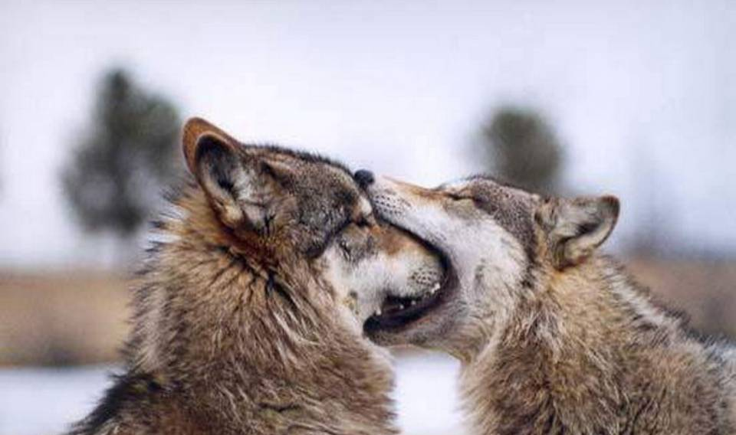
Resilience is increased when utilizing the locus of control most appropriate to the situation.
Notes:
Sometimes you need to be “alpha dog” sometimes you don’t. Maintain control of the things that are important and “relax” with the less important or unimportant issues.

Slide 27
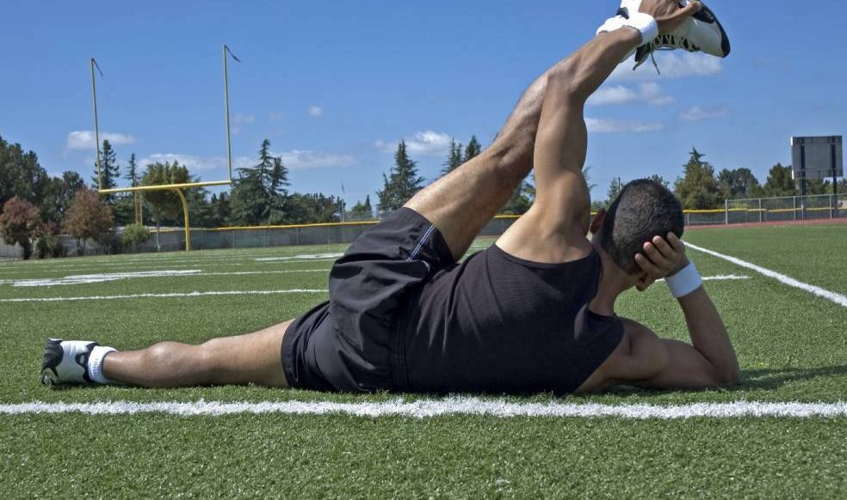
Flexibility
#2
Notes:
Allow yourself to experience strong emotions while also identifying when you need to temporarily shelve them in order to keep functioning.
Rely on others; this gives them permission to rely on you. Be prepared to do both.

Slide 28
Mindfulness
#3

Slide 29
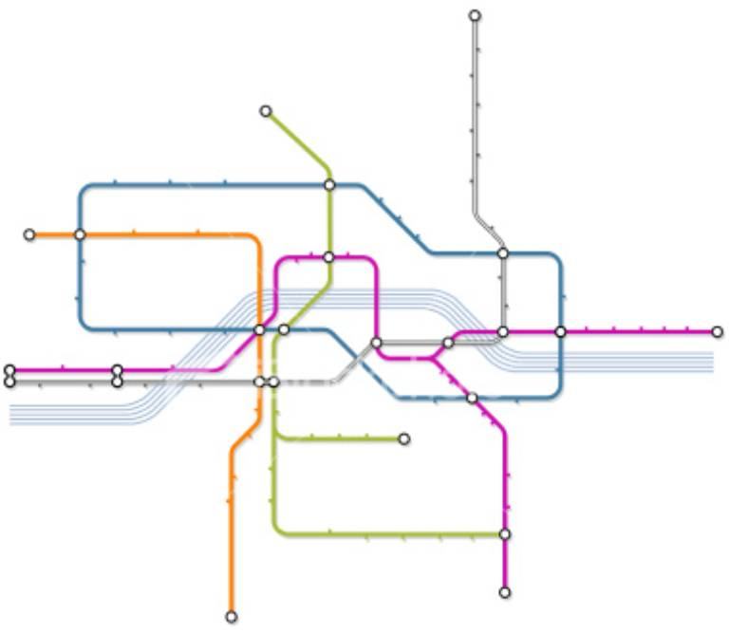
Map and Amplify Resources
#4
Exercise
Friends
Humor
Family
Team
Work
Nutrition
Rest
Spirituality
Get-aways
Notes:
Constantly identify and develop tools and capacity for problem solving

Slide 30
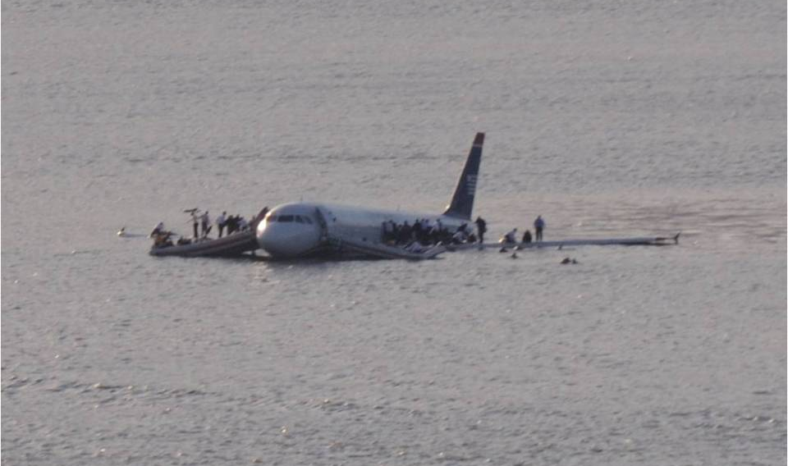
Planning and Practice
#5
Notes:
“At its most basic level, being prepared means having a solid plan and access to the resources necessary to execute that plan. It's also about peace of mind. Because when communities, families, and individuals are prepared, the fear, anxiety and loss that accompany a disaster are greatly reduced.” www.readycolorado.gov
“Preparedness is the foundation for resilience”
- Missouri Disaster Communication Guidebook, 2006
Review your plan with all involved in it’s implementation every 6 months
Practice the plan at least once per year so:
each member of the family knows and understands their job
You can identify areas that need updating
Practicing helps identify beliefs and emotional responses that are best addressed during a practice rather than an actual disaster

Slide 31
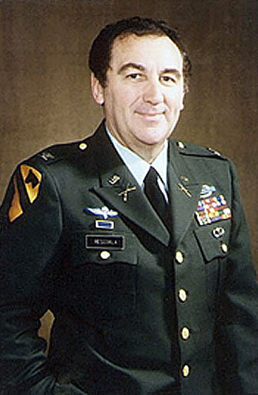
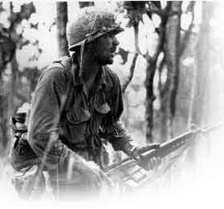
Richard “Rick” Rescorla
Notes:
UK Military: 1957-1963 in Cyprus then Rodesia/Zimbabwe
Vietnam: 1963 – On Tour
World Trade Center: VP Security - Morgan Stanley

Slide 32
Decision Making
https://www.ucalgary.ca/utoday/issue/2016-01-07/brain-imaging-helps-researchers-see-how-physicians-make-decisions

Slide 33
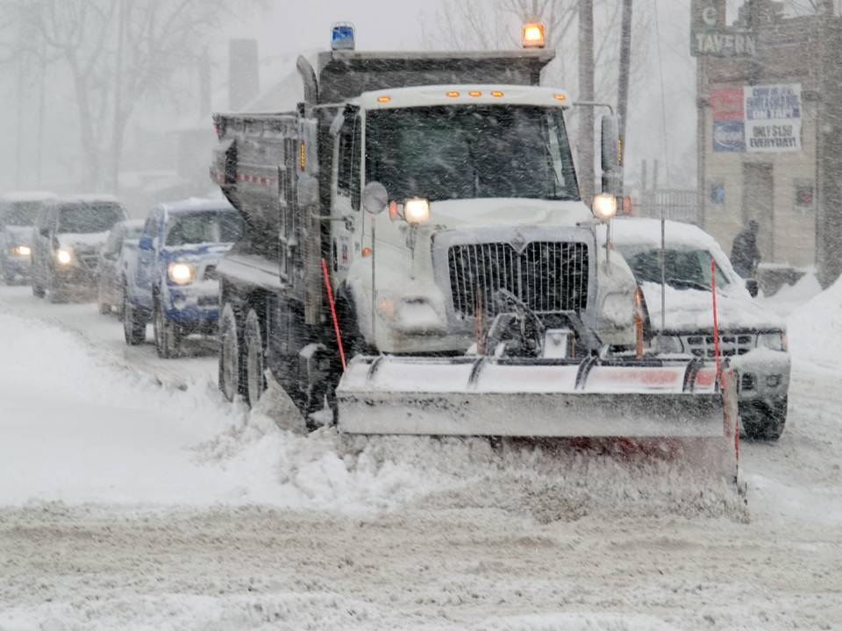
What’s Likely?
FEMA/<Michael Rieger taken on 12/20/2006 in Colorado>
Notes:
Prepare and supply for the most likely while addressing the less likely disasters

Slide 34
Financial and Other Important Documents
Notes:
Bank and investment accounts; credit and debit card information
Insurance policies, homeowner’s insurance policies
Health insurance (policy numbers, prescriptions, serial numbers for durable medical equipment)
Social security numbers, passports, and drivers’ licenses
Store documents, photographs and keepsakes in a box that is:
Portable
Fire-resistant
Waterproof

Slide 35
Communication Plan
Notes:
Establish ways to let your family know you are safe and they are safe
Establish ways for your family to contact you to know you are safe
Establish an out of state contact (friend or relative) in the event of a large-scale disaster
Make sure everyone knows how to use text messaging
Put I.C.E. (In Case of Emergency) in the cell phone directory for each family member of your family (www.icecontact.com)

Slide 36
Limits
#6
Notes:
Resilient people support their energy resources by protecting their personal boundaries and knowing when to say enough. When working with children in disaster response, shifts must be short with extended recovery time.

Slide 37
Balance
#7
Notes:
Seek balance between action and rest. Listen to your body; engaging in a physical activity is great for releasing tension and can help prepare us for rest. Listen to what your body needs.
Study indicating the benefits of a single episode of exercise:
-Increased positive well-being and energy after 30 minutes
Do not have to do 30 minutes of exercise all at once:
-can do 10 minutes in the morning, noon, and evening with the same effect
The concept of balance reinforces the importance of balanced nutrition as well
“what we eat and drink affects how we think and feel”

Slide 38
Family and Friends
#8

Slide 39
A Tale of 2 Parents

Slide 40
THE GLASS BRAIN PROJECT
Gazalley Lab Research , University of California at San Francisco USA
Notes:
This video is from The Glass Brain Project from Dr. Adam Gazzaley (GAZZ uh lay) at the Neuroscape Labs at the University of California at San Francisco USA. The Glass Brain Project is a 3D virtual reality video software game program that uses several brain imaging techniques to observe live brain activity when a person is performing a task. The star of the movie is only moving her hand and opening and shutting her eyes. As this video begins you are looking into her right ear and we will move around to the other side. When we get to the back, we’ll dive into the corpus callosum. (Click to start) All of the yellow spaghetti-like strings are bundles of white matter and the colored balls are electrical waves that are color coded to their individual frequencies.
This video shows one person doing something very simple; it’s not like she’s trying to solve complex problems.
While advances in neuroscience are interesting, the relevance of today’s Emergenetics workshop is to focus on understanding the strengths and effectiveness of your unique thinking and behavioral styles.
And that’s what Emergenetics does. On one sheet of paper like this. (Point to Emergenetics Metaphor) Emergenetics is a statistically valid psychometric tool, AND a metaphorical model of how your brain works.
OPTIONAL – If you think that the Glass Brain video is exciting, there’s more.
The primary purpose of the Project is to create custom video games which will be used treat early dementia or autism. Each of the games will undergo rigorous research and proceed through FDA approval prior to being available as a medical therapy. Here is a link to the first report: (http://gazzaleylab.ucsf.edu/home/gazzaleylab/Anguera_Nature_2013.pdf). You can follow Dr. Gazzaley’s work at https://neuroscape.ucsf.edu.

Slide 41
Caffeine & Alcohol Decrease it!

Slide 42
Sleep – Increase it!

Slide 43
Nutrition Balance it!

Slide 44
Exercise Do it!

Slide 45
Time-Outs - 20 Minutes

Slide 46
Leisure - Enjoy it!

Slide 47
Expectations – Keep them Realistic

Slide 48
Perceptions Be Gentle

Slide 49
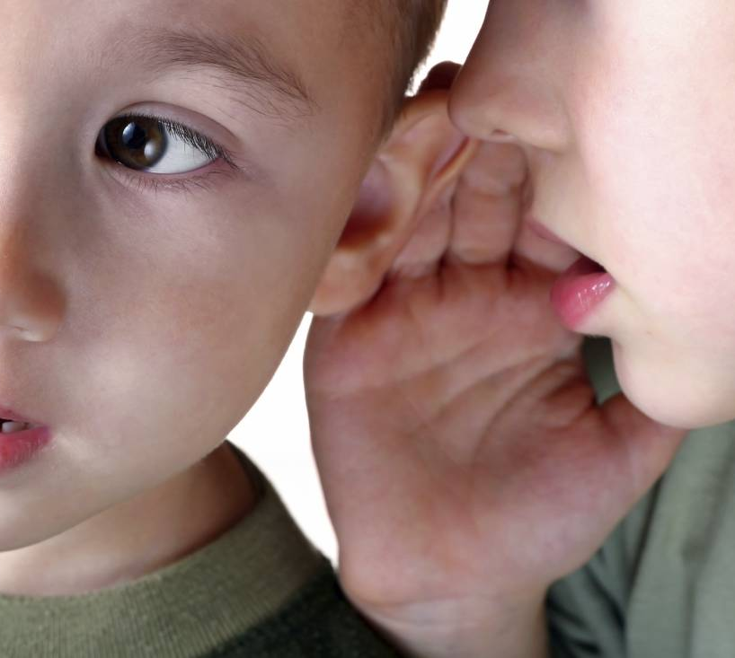
Challenges – Talk About them

Slide 50
Humor – Laugh…a lot!

Slide 51
Organizational Resilience
Notes:
Trained and empowered managers can support employees in building individual and team resiliency. In turn, resilient and empowered employees contribute to the resiliency of managers, leadership, and the organization overall.

Slide 52
How do we maximize our collective capacity, to achieve greater effectiveness, engagement, retention and sustainability?

Slide 53
Why are they asking the question?
33% of employees are engaged at work
53% of employees are disengaged at work
14% of employees are actively disengaged at work

Slide 54
Why are these numbers so low?
21% believe their performance is managed in a way that motivates them to do outstanding work
22% strongly agree that the leadership of their organization has a clear direction for the organization
15% strongly agree leadership makes them enthusiastic about the future
13% strongly agree leadership communicates effectively with rest of the organization

Slide 55
What’s the employee mindset?
51% of employees are actively looking for new jobs or watching for openings
63% believe it is very likely or somewhat likely that they can find a job equally as good as the one they currently have
19% thought it was a good time to find a higher quality job in 2012; 42% think that as of 2016

Slide 56
Imagine if the workforce in your organization was fully engaged…
41% decrease in absenteeism
24% decrease in high turnover organizations;
59% decrease in low turnover organizations
70% decrease in safety related incidents
17% increase in productivity

Slide 57
Optimal Performance How do you recognize it?
Personal
Team
Organizational
What does it take to create it?

Slide 58
Optimal Performance Tenure x Talent x Engagement
Notes:
How would you describe “Optimal Performance?”
Tenure = 10 years or longer
Ref: Gallup

Slide 59
5-15% of organizations reach Optimal Performance
Notes:
What might contribute to agencies’ inability to achieve optimal performance?

Slide 60
Challenges
High Effort/Low Reward
High Demand/Low Control
Nature of the work
Competence – Job Knowledge
Speed of Changes
“Hostile Work Environment”
Budget Constraints
Workloads
Structure or Supervisor relationship
Geographical Distance

Slide 61
Drivers of Resilience
Optimal Performance Talent Tenure Engagement
Employee Engagement Mastery Autonomy Purpose
Manageable workloads
Opportunities for training and professional development
Enhanced employee control
Recognition and reward of effective employees
Fostering of work-life integration
Notes:
The single most important factor in work satisfaction is the employees relationship with his/her supervisor.

Slide 62
Steps Leadership Can Take
Reward employees for acting resiliently
Be honest and open with employees about challenges, changes and potential impacts to the organization.
Train and assist management in learning different methods and communication styles and ensure they implement best practice with their employees.
Provide employees with as much control over their work and workplace as possible.
Remember to cut yourself some slack
Model resilience in your own life
Provide opportunities for ongoing learning and professional development.
Include employees in conversations and decisions about things that impact their work, and in which they have expertise.
Make sure your organization is focused on learning and improvement.

Slide 63
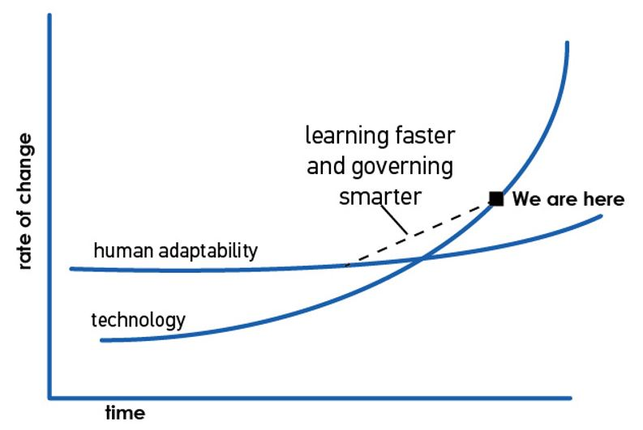
The Speed of Change
Eric “Astro” Teller’s Graph
http://www.medspeed.com/?p=2254

Slide 64
A Learning Environment
Fail fast and mindfully
Premortems
Brain Trust
Red Teams
After-Action-Reviews

Slide 65
Contact Information
Beth Roome
Switchback Institute
info@switchbackinstitute.com
303-594-8953
Strategies for Optimal Performance and Enhanced Resilience

