Slide 1
Collaborative Leadership Community Action
Servicios de La Raza/Services for the People
and
National Council on Aging
May 14, 2019
Notes:
Vivian will introduce session and welcome attendees--- then Rudy will introduce himself, Servicios history, programs, mission, then Vivian will continue with NCOA’s mission

Slide 2
About NCOA
Who We Are: NCOA is the national voice for every person’s right to age well.
Our Vision: A just and caring society in which each of us, as we age, lives with dignity, purpose, and security
Notes:
Lura

Slide 3
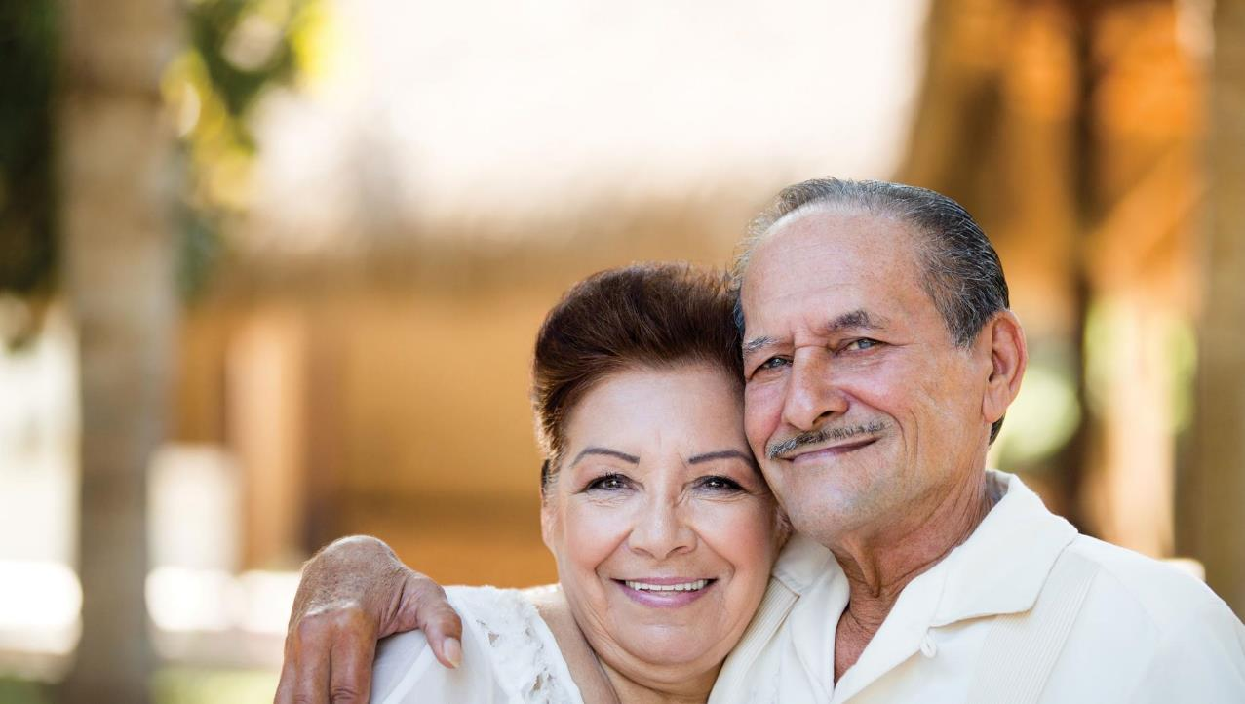
Our Mission: Improve the lives of millions of older adults, especially those who are struggling
Our Social Impact Goal:
Improve the health and economic security of 10 million older adults by 2020
Notes:
Lura

Slide 4
NCOA’s Networks of Community Partners
National Institute of Senior Centers (NISC)
Chronic disease self-management education programs
Center for Healthy Aging
Falls prevention coalitions
Center for Healthy Aging
Economic service centers
Center for Benefits Access
Benefits Enrollment Centers
Center for Benefits Access
Hunger initiative partners – SNAP grantees, WalMart Foundation
Center for Benefits Access
Senior Community Service Employment Program (SCSEP)
Aging Mastery Program®
See our partners at www.ncoa.org/map
Notes:
Lura

Slide 5
The Benefits Enrollment Center (BEC) Network
NCOA’s Center for Benefits Access receives funding from the U.S. Administration for Community Living to support the creation of BECs (since 2009)
BECs provide seamless systems of outreach, enrollment, and follow-up to help low-income Medicare beneficiaries with core programs that improve economic security & health:
Part D LIS/Extra Help
Medicare Savings Programs (MSPs)
Medicaid
Supplemental Nutrition Assistance Program (SNAP)
Low Income Home Energy Assistance Program (LIHEAP)
Other benefits

Slide 6
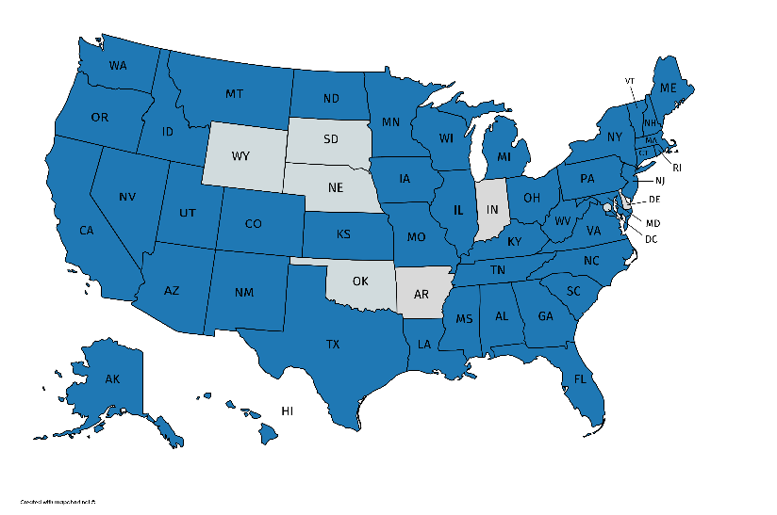
Benefits Enrollment Centers
Currently, 87 BECs serve individuals in 43 states
Notes:
Lura-
The shaded states represent where BECs currently serve. Some only operate in specific counties/communities, while others are statewide

Slide 7
Collaborative Leadership (National)
BECs vary by type and model of operation:
Statewide call centers
Ethnic community groups
Senior centers/area agencies on aging
Hospital systems
Faith-based groups (e.g., Catholic Charities)
Food banks
All of them have a goal of connecting low-income seniors/younger adults with disabilities to all of the benefits they may be eligible for (the person-centered approach)
Notes:
Lura-
There’s no cookie cutter formula for what makes a good BEC. Some are small community-based non-profits while others are part of larger networks of state agencies providing aging services. All of them are committed to serving vulnerable populations and connecting them to the programs they may be eligible for—and many go above and beyond that to link their clients to other sources of support in the community, such as housing, transportation, food pantries

Slide 8
Community Action (Local)

Slide 9
Servicios de La Raza/Services for the People
Who we are:
Founded in 1972 by community activists in Colorado, Servicios de La Raza embodies the phrase “for the people, by the people”.
Dedicated service of our mission to provide and advocate for culturally responsive, essential human services and opportunities to our community.
Initially began in an effort to support the under served Latinx community, has expanded to ALL communities, irrespective of age, race, gender, sexual-orientation, etc, with respect and dignity.
The organization was founded by those MOST impacted by social and economic challenges
Servicios de La Raza embraces and welcome ALL with open arms.
Notes:
Lura-
Our BECs have taught us some great lessons about forging partnerships and expanding outreach to communities.
Trust building example: At Isabella Geriatric Center in New York City, benefits specialists attempted to bring “SNAP on the Road” at several senior centers to help older adults apply for the Supplemental Nutrition Assistance Program. However, insufficient time was spent gaining the trust of the people living in the senior center communities and the project goals were not met. Carol Ban, Director of Aging in Place Programs at Isabella noted, “It would have been more effective to simplify the approach by focusing on one senior center, with a steady weekly presence, and engaging the community to build trust.”
Consumer advisory committee: Rio Arriba/Northern New Mexico BEC did this to better understand the needs of their Spanish speaking and Native American clients. The Senior Advisory Committee holds listening sessions to gather community input about their needs
Partners example: The Arc of Prince George’s County (PGC) in Maryland had three established grant partners under their BEC and believed that with a reach of 10,000 potential beneficiaries, these partners would bring in at least 75% of their referrals. However, when the referrals weren’t coming in the Arc of PGC realized that partners needed more support and guidance.
“Due to high turnover rates for case managers within our grant partner agencies, we needed to do multiple follow-up and face-to-face trainings at their staff meetings.”

Slide 10
Servicios de La Raza: Inspired by Excellence and Innovation
Programs:
Statewide Services Programs
BES- Basic Emergency Services Program
WAGEES4U- Work and Gain Education & Employment Skills
VISTAS – Victims in Safe Transition and Self-Sufficiency
Behavioral Health
TJCC – Transition from Jail to Community Collaborative
STEP- Skilled Trades Education Program
La Raza Youth Leadership Institute
Notes:
Rudy will provide an overview of Servicios’ programs and focus areas- how they work to lift up communities

Slide 11
Senior Hunger and SNAP
10.2 million older Americans faced the threat of hunger, representing 15.8% of adults aged 60+ in the U.S.
Participation in the SNAP program reduces food insecurity overall by 30%​
58% of seniors who qualify for SNAP do not participate in the program.
The median SNAP benefit for households with an elderly person in 2016 was $124 a month.
Notes:
Only 41% of eligible seniors nationwide are actually enrolled and receiving SNAP benefits. This is in contrast to general population enrolment and has created a “senior SNAP gap.” Some 83 percent of all eligible men, women and children receive SNAP benefits to help supplement their monthly food needs.

Slide 12
Senior SNAP Enrollment Initiative: Phase 4
$4M funded by Walmart Foundation, May 2018 – June 2020
Objectives:
57,500 SNAP applications submitted by community partners, with a special focus on reaching rural/immigrant seniors (~43,125 enrollments)
1,000,000 seniors connected directly with SNAP information and applications on BenefitsCheckUp® (~165,000 enrollments)
Utilize 3 novel delivery channels – SMS text messaging, video, and webinar/toolkit – to reach 60,000 consumers with information about SNAP, seniors, and local advocacy​
In total, we will help 387,500 seniors apply for SNAP in Phase 4, a 27% increase over Phase 3 objectives

Slide 13
Senior SNAP Enrollment Initiative
Servicios de La Raza/Services for the People
NEW SNAP Grantee, 2018
Scope of SNAP focus
How will this expand Servicios’ reach to seniors?
How will other already established programs work to aide in this effort?
Notes:
Rudy – will provide an overview of the SNAP opportunity as applied to Servicios, the length of the opportunity, the way we were connected and how NCOA is working to connect with key leaders and organizations who focus on the communities most vulnerable.

Slide 14
SNAP Initiative - Update
Progress to date:
25 SNAP grants awarded to CBOs in 19 states
23,482 / 57,500 SNAP applications submitted
417,209 / 1,000,000 SNAP downloads
SNAP Advocacy Toolkit updated
SMS Text Message Pilot launched March 26th
Coming soon:
Senior SNAP Journey Video May 2019
Advocacy webinar for all grantees and Advocacy Day 2019

Slide 15
Why collaborative leadership at the national level matters
Taking a national issue and localizing outreach, partnerships.
Empowering those in the community to lead efforts and identify what works best in their communities.
Circling back with national leaders to frame the issues and provide feedback on possible solutions.
Continuing to check in with community partners and provide opportunities for national advocacy and or education that has a state level or local impact.
Notes:
Vivian

Slide 16
Break Out
Break Out 1: (Empowering)
Partnering to increase outreach with hard-to-reach populations
Break Out 2: (Frame the Issue)
Partnering on marketing plans and communications to broaden reach to particular audience or on a particular topic impacting older adults
Break Out 3: (Opportunities for national advocacy or education)
What types of partnerships would help to do this? How can local organizations or state organizations connect with national organizations and vice versa?
Notes:
Vivian

Slide 17
NCOA Key Partnerships
Administration for Community Living chronic disease self-management education and falls prevention grantees
Aging and disability resource centers
Area agencies on aging
Community-based organizations
Falls Free® Initiative State Coalitions on Falls Prevention
Health care organizations
Senior centers
State health departments
State offices on aging
Tribal organizations
And, many more…https://www.ncoa.org/center-for-healthy-aging/about-cha/cha-partners/

Slide 18
Why Do Partnerships Matter?
Notes:
Vivian:
Collaborative leadership; “Rising tides lift all boats”
Mobilizing communities embeds brand awareness in the lives of everyday people
Familiarity with communities and contextual constraints provides opportunities to identify shared values
The opportunity for those outside the sector and or business, to identify opportunities for addressing societal problems
They matter most when they emphasize transformation over transaction

Slide 19
Who: 700+ professionals and advocates working at the local, state, and national levels to improve the health and economic security of older adults www.ageaction.org Where: Washington, DC Renaissance Hotel
NCOA’s Age+Action Conference
Notes:
Lura –
Highlights
Plenary sessions focused on the aging experience for American women
Educational sessions featuring best practices in evidence-based healthy aging programs, benefits outreach and enrollment, and senior center programming
Awards recognizing leaders championing older adults and every person’s right to age well
Capitol Hill Day to educate your members of Congress
Networking and social events
Expo Hall
And more …

Slide 20
Servicios de La Raza 7th Annual Gala
Notes:
Lura –
Highlights
Plenary sessions focused on the aging experience for American women
Educational sessions featuring best practices in evidence-based healthy aging programs, benefits outreach and enrollment, and senior center programming
Awards recognizing leaders championing older adults and every person’s right to age well
Capitol Hill Day to educate your members of Congress
Networking and social events
Expo Hall
And more …

Slide 21
Learn More
Visit ncoa.org and sign up for news, policy alerts, new blog posts, networking with the broader aging affiliates and National Institute of Senior Centers (NISC) Visit ncoa.org and sign up for news
Follow @NCOAging on social media
Share NCOA’s free, trusted tools with older adults
BenefitsCheckUp.org
MyMedicareMatters.org
Rudolph “Rudy” Gonzales
Executive Director, Servicios de La Raza
Preferred Pronouns: He, Him, His, Himself, El
Office: 303.458.5851
Direct: 303.953.5905
www.serviciosdelaraza.org | www.facebook.com/serviciosdelaraza
Vivian Nava-Schellinger
Associate Director, Strategic Partnerships & External Affairs
National Council on Aging
Vivian.Schellinger@ncoa.org

