Slide 1
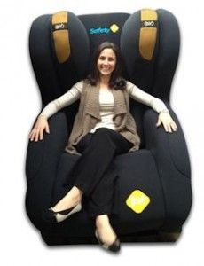
The Millennial in the Backseat
April Murray
Director of Interim Executives
LeaderStat
Notes:
April Murray, Executive Leadership Consultant
LS provides executive leadership recruiting, consulting and interim solutions in post-acute and acute settings.
We have about an hour together, wrap this up in 45 mins
50 text messages by that time
Been with my company for about a year and deserve some vacation time
Taking rest of the afternoon off
Speaking of which, I feel like a year is a really long time,
Looking for a new opportunity soon, if any of you are hiring, I can e-mail you my resume
Painted a pretty clear picture that I’m a millennial
Part of my identity that for many years made me cringe
I've felt like the minute I've shared that I’m a millennial I've immediately discounted all of my hard work and successes.
Yet, I’m indeed part of this lazy, job-hopping generation
Before we go any further, what words come to mind when you hear the term Millennial?

Slide 2
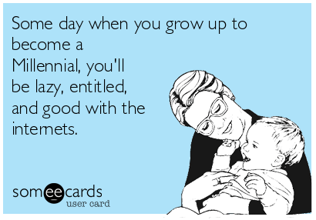
The Perceptions We Hold Today
Lazy
Entitled
Job-hopper
Addicted to technology
Needy
Not Committed to Work
Disloyal
Self-Absorbed
Notes:
Lazy
Entitled
Job-hopper
Addicted to technology
Needy
Not committed to work
Disloyal
Self-absorbed

Slide 3
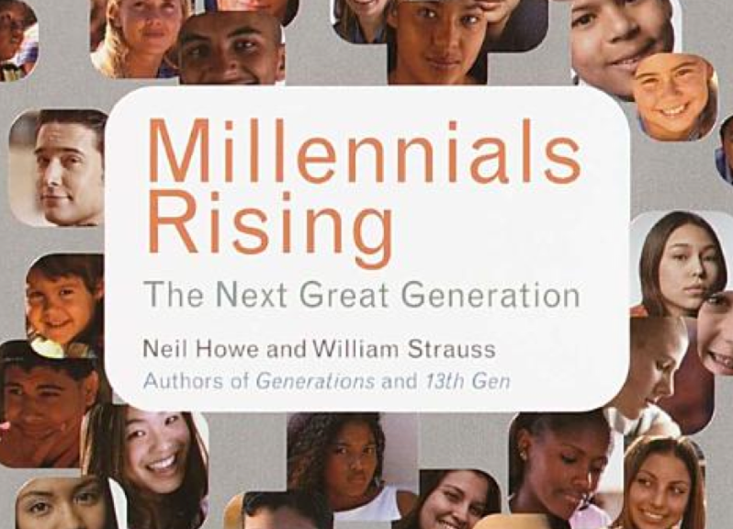
Where did these perceptions come from?
Published in 2000, prior to the huge social media boom
Qualified researchers spent hours collecting data for solid representations
Very positive view on Millennials
Notes:
So where did these perceptions come from?
Initially, theories presented by qualified researches like Neil Howe and William Strauss
Hours collecting data
Positive view on millennials
Prior to huge social media boom
LATER, other generational analysts came out with books
The Me Generation and The Dumbest Generation
Used social media as a jumping off platform
As we all know social media helps unreliable data spread like wildfire…

Slide 4
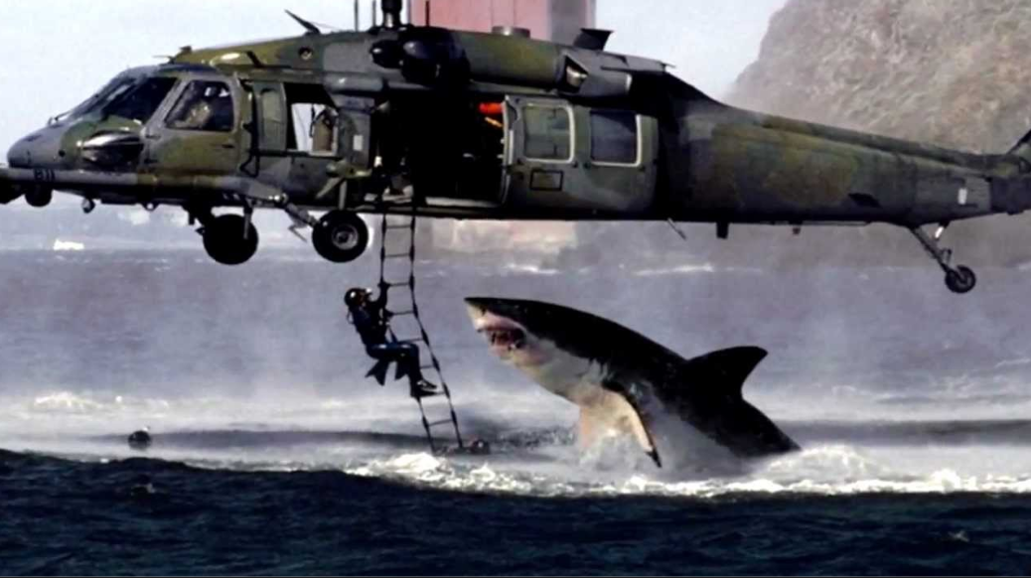
I saw it on the internet….it must be true!
Notes:
And if we read it on the internet than it must be true.
Negative perceptions make way better headlines and so the damaging perceptions of millennials was born
Job since 14, 1st at McDonalds (McFlurry)
After that job as a dishwasher, moved up to bussing tables and then eventually waitressing
Worked throughout HS and college
1st generation college grad
By age of 25, managed a team which included of 2 baby boomers (quite the learning experience)
Typically ppl will say, “You’re a millennial? Well you’re the exception” or “I’m talking about millennials that are 25, not 32”
These justifications seek to hide one of the biggest inconvenient truths- perhaps millennials are not, in reality, lazy, entitled, feedback driven job-hoppers their believed to be.
Maybe, instead of focusing on generations and millennials, focus on the modern talents behavior and workplace design.
Despite the heavy focus on millennials, its not about them.
Its about what makes modern talent, in the context of todays digitally enabled environment engaged and productive.

Slide 5
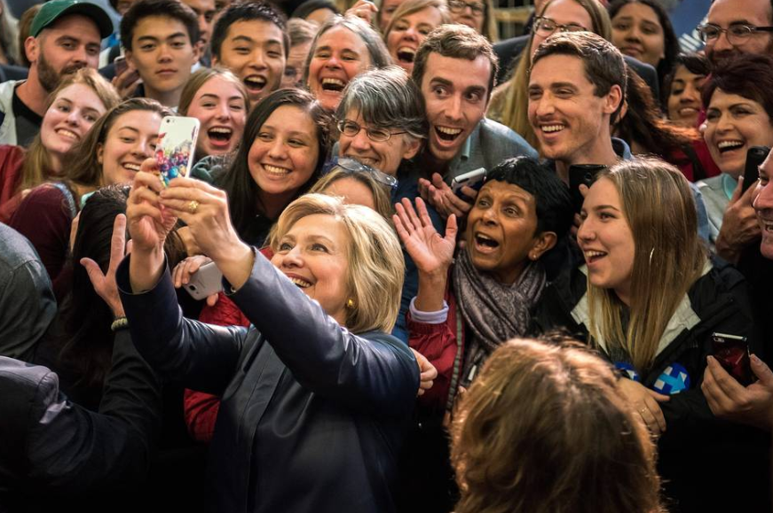
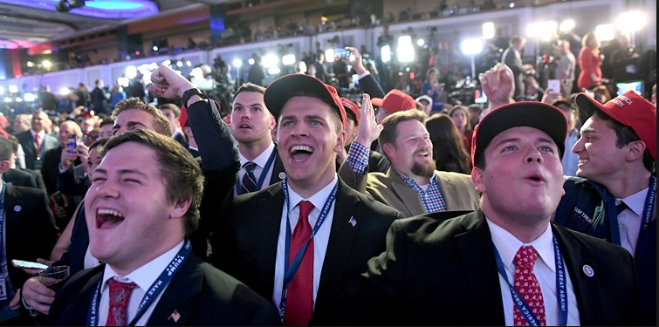
Notes:
Over 20 articles a day published on the internet about Millennials
Topics ranging from
Home buying habits
Pop culture trends
How we choose to vote
Constantly flashing up on our news feeds, in our emails, on social media.
With all of this information at our finger tips its no wonder we believe the drama we hear.
Every generation has dealt with negative perceptions; but never in such a high-volume, fast-paced way
Essentially, through social media we have begun to accept the crystal ball predictions as truth rather than validating and confirming

Slide 6
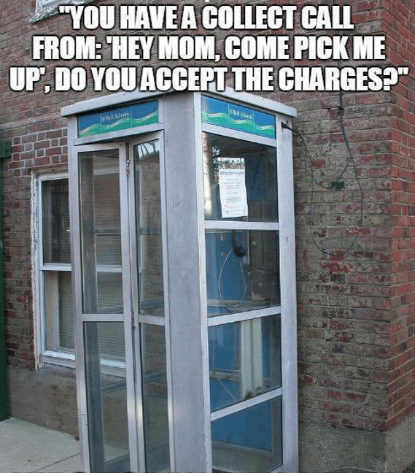
Notes:
The interesting thing about Millennials are 1st generation to grow up with computers, the internet and digital technology.
Also last generation to know what life was like before being digitally enabled.
I didn’t have a tablet in my crib
Grew up in Akron, close to Geauga Lake
Elementary school- book reports from Encyclopedia Britannica
By the time I got to college I had a cell phone, for emergencies only. Not a fancy iPhone, large Nokia.
Computer with monitor 18” deep
So I have this unique experience of having and not having technology

Slide 7
“ The root cause behind the challenges of attracting and retaining millennials in the workplace lies within this widespread avalanche of misunderstanding”
–Crystal Kadakia,
Consultant on Millennials
Notes:
Incredible book by Crystal Kadakia, Millennial Myth
Talks about today only having a slice of the overall picture presented by
White papers
Top 10 lists
Videos
Books
Blogs
TV interviews
Misguided speakers and trainers
Pew research conducted study in 2015 on how generations perceive themselves
Only 8% of millennials feel the generational labels describe them well
Furthermore, highlights that millennials are their harshest critics, unlike any other generation
Millennials internalize the medias negative perceptions of them even though 92% don’t identify with the labels
Significant disconnect between the characteristics assumed by millennials and the reality that millennials experience

Slide 8
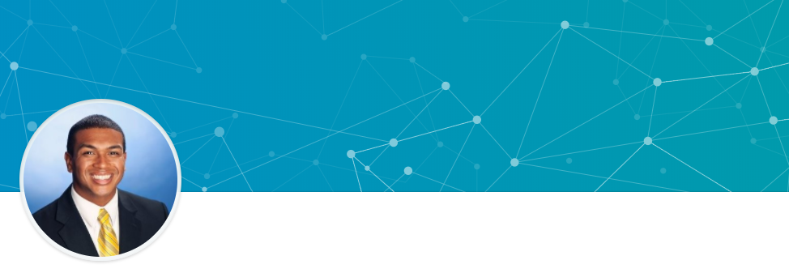
“As a millennial leader I love being challenged everyday. Managing different demographics from younger to older millennials, as well as individuals that may be in Generation X has given me the opportunity to adapt to different personalities, environments, experiences, and perspectives.”
– Jordan Farmer
Notes:
I want to talk to you about 2 successful Millennial leaders
Jordan Famer, Director of Interim Services. (hesitated using him as example)
Has been with LeaderStat for 6 years, not 6 months.
What keeps Jordan engaged?
The challenge! Leads one of most difficult divisions
Director by the age of 28
Challenged to employees, consultants, and clients based off his age
Finds himself having to prove himself to these audiences, “What does this young guy know”, “What kind of experiences can this young guy have?”
You would not believe the compliments Jordan receives from his clients about his approach and how he handles himself as a professional
Leading different generations has afforded him the opportunity to showcase his skills by being able to adapt to different personalities, environments, experiences and perspectives.
Has lead a team that has doubled their revenue year after year for the last 3 years.
Division makes more revenue than other divisions combined
Kicks butt! Not what you might typically expect out of a millennial.

Slide 9
“Feeling emotionally satisfied at the end of the day…that’s what drives me.”
-Jenelle Maddox
Notes:
Jenelle Maddox, Account Manager with large Marketing firm in Cleveland
Prior to taking AM job, Jenelle worked as Account Executive for Fortune 500 Company.
Quickly became one of the top preforming sales executives in her region, outperforming many senior execs.
By her late 20’s Jenelle was making way above 6 figures
Bought first home with a considerable down payment in cash
Driving luxury vehicle
Luis Vuitton purses
Traveling the world
NOT HAPPY
Stressed and didn’t feel valued. Even though top performing sales exec she felt like nothing was ever good enough.
Customers often unhappy.
After 3 years decided to look for a new opportunity
Not making 6 figures, not traveling, STILL carrying that Louie
Feels emotionally satisfied, appreciated, Customers send thank you cards.
Money doesn’t drive this generation, purpose and meaning does.

Slide 10
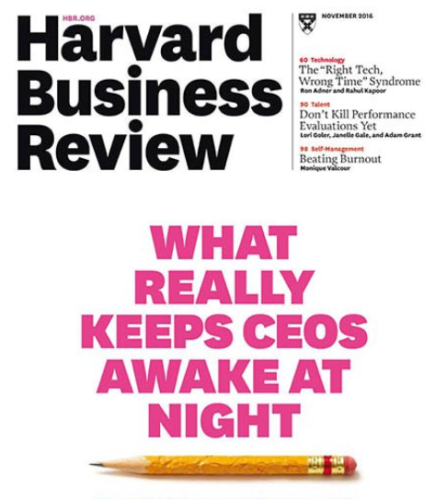
Managing and retaining the Millennial workforce!
Notes:
On the 2016 cover of Harvard Business Review was the title of an article called, “What Really Keeps CEO’s up at Night?”
Among the major challenges discussed in the article
One was managing and retaining the millennial workforce…

Slide 11
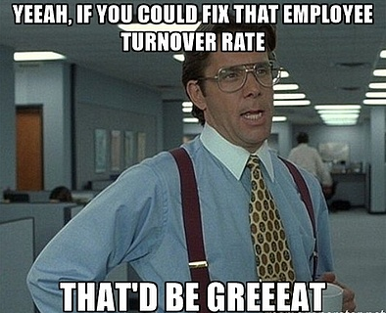
The cost of employee turnover means:
Financial repercussions
Lower knowledge base in company
Decreased performance and work morale
Notes:
Let’s talk a little bit about the healthcare workforce and specifically retention rates
No secret that healthcare is facing nursing shortage crisis-
In addition to high employee turnover
Healthcare has the 3rd highest turnover rate of any other industry right now
Last year, the turnover rate for bedside registered nurses (RN) was 16.8%, and the turnover rate for certified nursing assistant (CNA) was 27.7%
The cost of those turnovers averaged $49,500 per position replaced.
Cost of employee turnover not only has
HIGH financial repercussions
It lowers the knowledge base if the company
And decreases performance and work morale
When staff start leaving it creates a domino effect

Slide 12
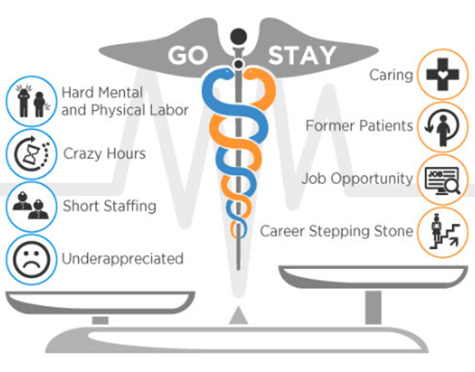
Notes:
The first factor is that of workload considerations. Employees or senior living facilities face tough workplace demands on both physical and emotional levels.
Employees may often be required to cover staffing shortages; in effect, doing more with less.
This factor can lead to employee burnout, and is responsible for the bulk of turnovers in the industry.
Pay tends to be on the low end for caregivers in assisted living facilities, especially among paraprofessional staff.
Related to low pay is the fact that employees may not have opportunities for career growth; employees may hit salary caps or not be able to expand their skill sets, leading to job dissatisfaction and low retention rates.
Finally, leadership roles and communication play a large part in employee retention. Disruptions in the chain of command, coupled with a loss in employee morale due to ineffective leadership, can drive employees away.

Slide 13
Today’s Labor Market
Low Unemployment
3.9% - lowest since 2007
More Competition
More choices on where to work
Open Positions Over 1 million RN openings by 2024
Notes:
There are many aspects of todays healthcare workforce that are positive
Also have significant challenging times which shows us that our market is in a drought
Looking at today’s labor market- lowest unemployment rate since 2007
Life as a leadership consultant looks a lot different today than it did 5-10 years ago
Why is that?
More competition
It is a candidate’s market today
When we go out to the market to find a candidate they’re often looking at 5 different opportunities and able to decide which one they like best
If they’re not already looking, we’re planted the seed in their mind to check what else is out there
By 2024 their will be 1 million RN openings in the healthcare industry
BUT there is light at the end of the tunnel…and that light is millennials!

Slide 14
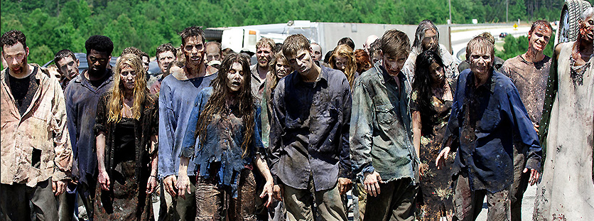
Like a scene from “The Walking Dead,” millennials are coming from all directions to dominate the workforce…
Notes:
Like a scene out of the Walking Dead, Millennials are coming from all directions to dominate the workforce

Slide 15
Millennials are twice as likely to become RN’s as Baby Boomers
Millennials are 60% more likely to become RN’s than Gen X’ers
Nearly 1/3 of all current nursing staff are under the age of 35 (Millennials) and that number will continue to grow into the next decade
Notes:
I shared that by 2024 there will be over 1 million RN openings, this is driven in part by the retirement of baby boomers
Ironically, millennials are choosing careers in nursing that nearly double those of baby boomers
Millennials are also 60% more likely to become RN’s than Gen X’ers, people born between 1965-1981
Nearly a third of current nursing staff are millennials and that number will continue to grow over the next decade
So, why? Why are Millennials turning to nursing…

Slide 16
The Great Recession
Meaningful work
Notes:
Study in 2017 by Advisory.com suggested two reasons:
Millennials came of age during the Great Recession.
They’re seeking jobs that have stable wages and low unemployment, such as Nursing
Another factor is
We’re looking for meaningful work and work that we care about
Remember my friend Jenelle who left her 6 figure job for a job that made her feel emotionally satisfied at the end of the day?

Slide 17
Notes:
Now that we know that the industry we’re serving is the perfect playground for millennials workers, lets discuss how to attract, retain, develop, engage and empower them.

Slide 18
Notes:
Attracting Millennials starts at the first interview
The candidate is also interviewing you
As we know, it is a candidates market and they're are looking at several different opportunities at the same time
Don’t just ask the candidates questions, take time to sell your organization, promote your mission and the culture of your organization
Taking the time to educate the candidate on your organizations culture will allow them to determine if they fit right from the beginning

Slide 19
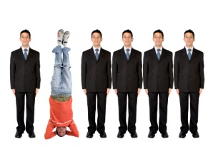
Starts with your mission and values as an organization
It’s not what you say, but why you say it…
Decision Making
Hire for attitude
History of job transitions
Style and approach: do they speak poorly of bosses
Let’s get personal
Don’t be fooled!
Notes:
When it comes to the candidate….try determining why they answered your questions they way they did
We often tell our clients to higher for attitude
Policies and procedures can be taught, but will this person fit in well with your mission and values
Dig deep and get personal; why did they make the transitions they made?
Are they speaking poorly of past employers or bosses?
Not everyone has made perfect career choices but do they have something negative to report about every previous employer?

Slide 20
If you find the right candidate….DON’T WAIT
Notes:
I often tell our clients…
If you’re looking to identify a husband or a wife in 3 months time, it likely won’t happen.
Market is tight right now
10 years ago we could hand-pick candidates, those days are gone
Make a list of job skills you would like to see
And ones you can live without
When you find that person, DON’T WAIT…they are interviewing elsewhere!
Make them an offer!

Slide 21
Notes:
In addition to marriage, divorce and the birth of a baby
A job change ranks right up there with major life choices
Success starts with pre-boarding

Slide 22
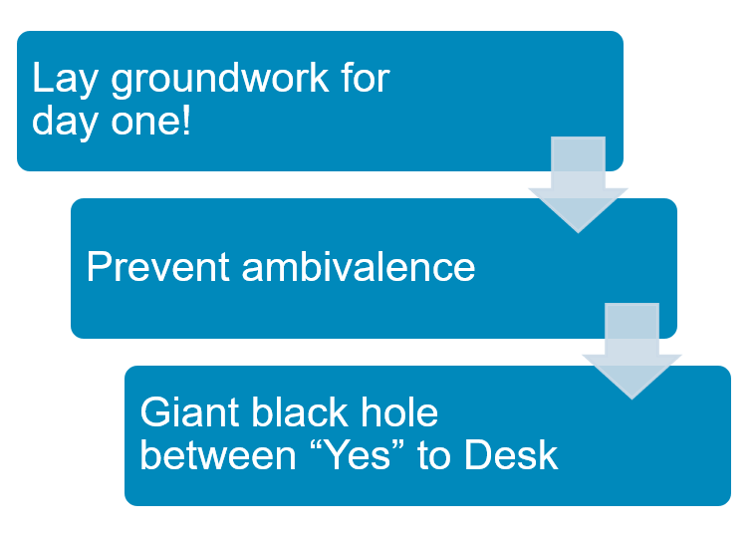
Pre-boarding will effectively…
Notes:
By taking steps to prepare for your new employees arrival you will:
Lay the groundwork for day one
Prevent ambivalence
Prevent that giant black hole between “Yes” and the “Desk”
After the first day, we find that support and guidance during the onboarding process plays a significant role in the success of new hires

Slide 23
Communication
Stay in touch from offer acceptance until they’re in the front door
Call, e-mail or text
Notes:
Communication is Key
Stay in touch with the candidate from the day the accept the offer until they walk in the front door
A simple 2 minute call, email or text goes a long way
Technology to schedule texts ahead of time

Slide 24
Send a formal announcement
(bulk e-mail or text)
Share info to see if there are common interests
Encourage staff to extend a quick welcome e-mail
Notes:
Send a very quick announcement of new employees hire and start date via a bulk-email or text and CC the new employee
Share information about your new hire to see if there are any combined interests with other staff members
Encourage your staff to extend a welcome e-mail
Tell story about start w/LeaderStat, so impressed
Now that we have the new hire/millennial in place let’s talk about ways to keep them engaged

Slide 25
Cultivate Your Talent
Help them feel a sense of accomplishment early on
Create a career ladder
Design career tracks for each position
Show them that they have the potential to move up
Identify measurable goals
Offer career development & training
Notes:
Cultivate Your Talent
Help them feel a sense of accomplishment early on
Create a career ladder
Design career tracks for each position
Show them that they have the potential to move up
Identify measurable goals
Offer career development & training

Slide 26
Focus on their personal development
Investigate their interests in growing with the organization
Focus training on enhancing job performance
Notes:
Focus on their personal development
Investigate their interests in growing with the organization
Focus training on enhancing job performance
eir interests in growing with the organization
Focus training on enhancing job performance

Slide 27
At Drive- We help your organization reach its full potential by showing you – step by step- how to create a high commitment, high performing organization.
Notes:
We partner with a lot of different organizations, One of those is DRIVE
Drive’s purpose it to help organization’s achieve their full potential by showing them – step by step - how to create a high commitment, high performing organizations.

Slide 28
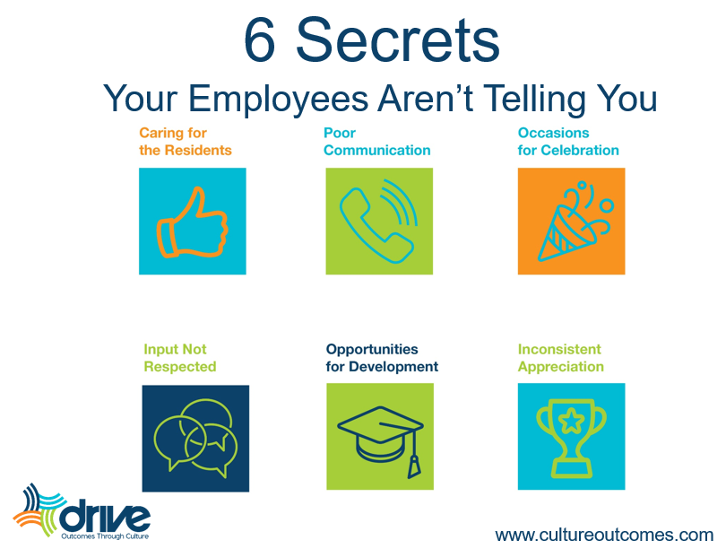
Notes:
One thing Drive shares with their clients are the 6 secrets that staff aren’t telling you, made up of 3 positive things and 3 negative things
1.) What gets you out of bed in the morning? Again, the emotionally satisfying part of our jobs- such as caring for residents or patients
2.) Occasions for Celebrations- think back to childhood, memories of vacations or holidays, same goes with staff
3.) Opps to development- Often seen as tuition reimbursement, grants for further education, BUT other opps for dev. Are boss helping with project for 20 mins
4.) Input not respected or recognized- or opinion is never asked. Best leader had took time to ask my opinion, even if it wasn’t used, had my buy in from asking
5.) inconsistent appreciation- Everyone likes to feel appreciated in diff. ways. Tangible gifts, private/public acknowledgement, Pat on the back
6.) Poor Communication- most often heard by disgruntled staff, “No one told me” or “ I didn’t know”. Which gives us opps to work on informal and formal communication

Slide 29
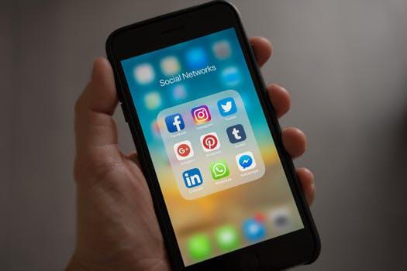
The need to feel connected electronically…
Notes:
Well known fact that WE ALL like to feel connected electronically
Use cell phone for a lot more than making phone calls
Alarm
Baby Development App- head of cauliflower
Track steps
Bank account
Son’s daycare uses an app to communicate with me throughout the day
Don’t even get me started on Amazon!
Many healthcare orgs have apps they use to communicate with patients about their medical charts or billing but
One of our healthcare clients decided to put that need to feeling connected to good use but creating an app specifically for their staff to increase engagement…

Slide 30
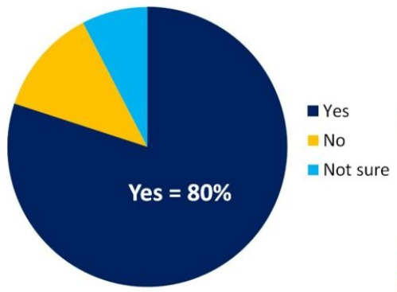
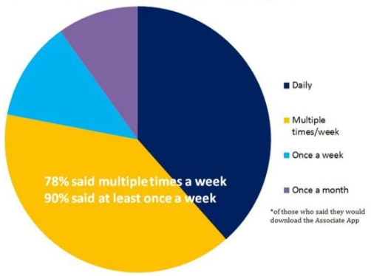
Would you use the Associates App?
How often would you use the Associates App?
Notes:
The app came about as an idea when they realized they were struggling to communicate with their staff via e-mail
Staff weren’t opening company-wide e-mails
Who would of thought a day when no on reads e-mail
Surveyed over 2700 employees and asked them if they would use a company app- 80% YES
How often would you use it?
78% multiple times, 90% said at least once a week

Slide 31
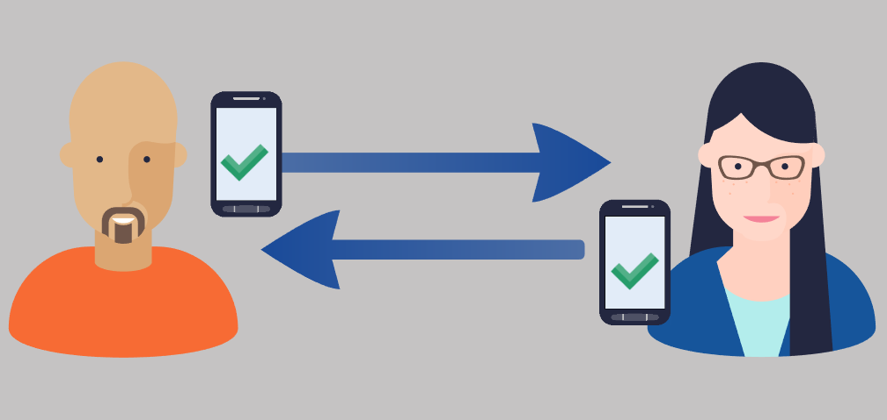
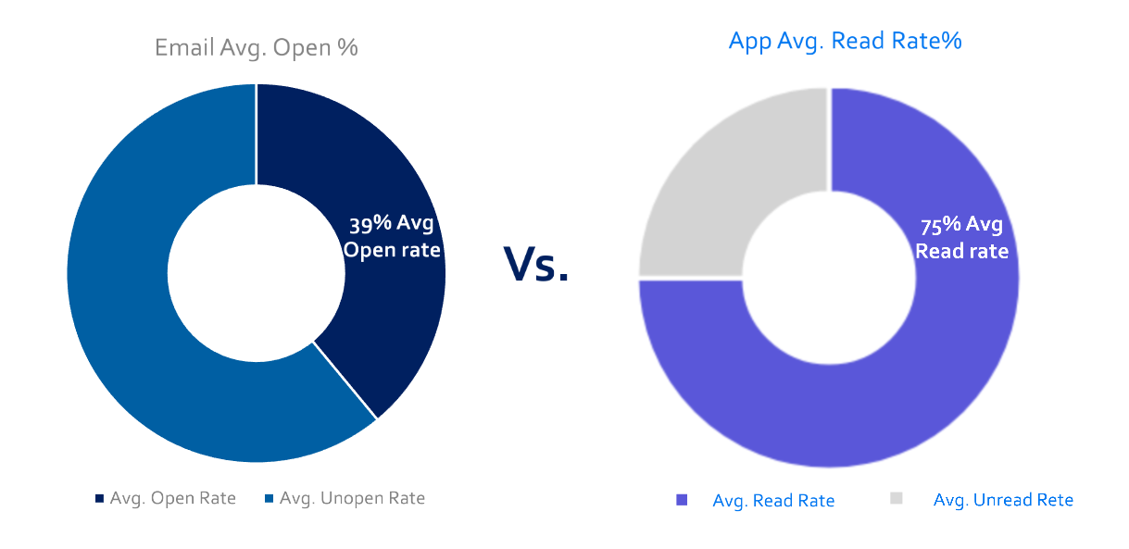
How does App engagement compare with e-mail?
Notes:
Prior to introducing the app, average e-mail open rate was 39%
Since introducing the app
Average read rate has increased to 75% in the first 6 months

Slide 32
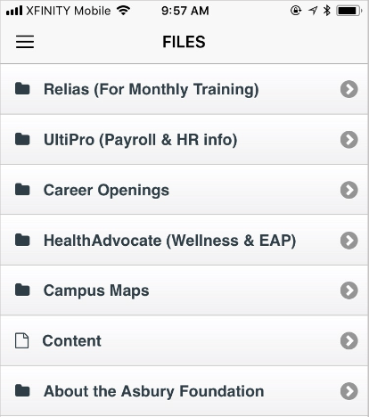
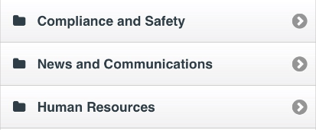
Connecting associates with the information they need.
Creating a more engaged workforce that leads to more satisfied patients & customers
Building a more efficient, productive organization.
Notes:
Not only has the app been an incredible communication tool but also allows users access to:
Relias (monthly training)
UltiPro (payroll and HR information)
Company wide career openings
Etc.…
Our client has felt that the app has connected their staff with the info they need which has
Created a more engaged workforce and
Lead to more satisfied patients and customers
Also, allowed them to build a more efficient, productive, workforce

Slide 33
How do you keep your workforce engaged?
Notes:
Let’s take 3-5 minutes to talk with the person next to you about ways you keep your employees engaged

Slide 34
Notes:
Do you feel good about working with Millennials?

