Slide 1

Residential Board & Care
Defend in Place
Understanding the New DFPC Guidance
FR
Craig Montoya, Plans Examiner
Shannon St. Hilaire, Health Facilities Liaison
Bryan Adams, Residential Healthcare Unit Chief
Fire & Life Safety Section
Division of Fire Prevention and Control Colorado Department of Public Safety
FABRIKAM RESIDENCES
Notes:
(shannon)
Introductions and background information for presenters given here.

Slide 2

Outcomes & Highlights
Understand Defend in Place (DIP) in Large Residential Board & Care
Explain Total Concept for DIP
List requirements for DIP
Know how to request DIP review
Q&A at the end
Notes:
Explain that all aspects of the DIP cannot be addressed here.
Ask what a LARGE ALR is per NFPA? (17 or more) (CDPHE is 20 or more)

Slide 3


Community Perspectives of Defend in Place
Who’s Here?
Is Defend in Place in Use?
What’s Defend in Place?
What Happens for Fire Alarm/Drill?
Notes:
Ask the audience:
Raise hand if ALR.
Who uses defend in place? (Ask for a show of hands)
What is defend in place? (Ask for a couple volunteers to explain in one or two sentences for their understanding of defend in place)
How does a facility defend in place? (Ask a couple volunteers to explain the procedure in practice)

Slide 4

Defend in Place Defined
NFPA General Definition
  2020 NFPA 101 3.3.17 - The operational response in which the action is to relocate the affected occupants to a safe place within the structure during an emergency.
Why Defend in Place
  Wholesale evacuation can be the least desirable emergency response action.
History of Defend in Place
  “Health Care” occupancy origin.
  Requires special building design, construction, and life safety features.
  Requires staff training and adequate staffing levels for efficacy.
Notes:
State the definition of DIP
Ask why you may not want to evacuate all residents?
Explain defend in place began in healthcare setting necessitating special construction and life safety features for DIP.
DIP requires good planning for the procedure which is trained and drilled and has enough staffing to effectuate the plan based on resident assessment.
These components were the origin of the “total concept” for defend in place.

Slide 5

Total Concept
Comprehensive approach with layers of safety features for limiting need for full evacuation during fire emergency.
Key Components:
Building design, construction, and compartmentation
Fire detection, alarm, extinguishing systems
Fire Prevention Procedures
Planning, training, and drill programs
Fire isolation
Occupant transfer to refuge areas
Total evacuation when necessary
Notes:
At the 30K ft view explain:
Compartmentation
Detection/Alarm/Suppression
Prevention/Planning/Training and drills
Adequate number of trained staff

Slide 6
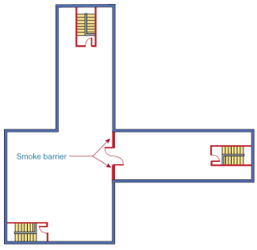
Essential Building Features
Smoke Compartmentation - Division of building into distinct zones constructed to limit smoke spread, allowing occupants to relocate to a safe space during a fire emergency.
Components of the Compartment
  Continuous membrane (walls/floor ceiling)
  Openings are protected/sealed (doors, ducts)
  Compartment boundaries
Inspection/Testing/Maintenance (ITM) Program
  System for identifying & inspecting all components
  Records for ITM activities
Notes:
Explain the following:
What a smoke compartment is
What makes a smoke compartment a smoke compartment
WHY staff have to know where the smoke compartments are and what they do
How keeping the smoke compartment functioning as intended is essential to DIP
Explain what is needed for the ITM program (LSC plans? Policy/procedure for reviewing the compartment features periodically? Documentation for ITM activities?)

Slide 7

Essential Building Features
Smoke Compartmentation - Additional Subdivision of Spaces Requirements
At least two compartments per sleeping floor
Hazardous areas (e.g., bulk laundry, storage rooms larger than 100 sq ft, trash collection rooms) are separated by smoke partitions
Notes:
(Craig)
Explain rationale for two compartments per sleeping floor. (Why can’t I just move residents to the next floor?)
Explain what a Hazardous area is.
Explain why hazardous areas need to be separated by a smoke partition.

Slide 8

Essential Building Features
Enhanced Egress -
Minimum corridor width requirement
  New Healthcare 18.2.3.4 (8 ft)
  Existing Healthcare 19.2.3.4 (4 ft)
  New, Large Residential Board and Care 32.3.2.3.3 (5ft)
Emergency lighting
  Complies with 2012 NFPA 101 7.9
  Inspection, testing, and maintenance
Notes:
Consider that hall widths are typically unalterable. Existing facilities may need to choose how to be reviewed based on hallway widths for their sleeping areas.
New buildings that plan to use defend in place will be evaluated to Chapter 32 and will require 5ft width.

Slide 9

Essential Building Features
Structural Integrity - Utilize materials that provide sufficient fire resistance for internal relocation
Building type identified and maintained
Smoke and/or fire doors tested and maintained
Fire resistant building finishes
Fire alarm inspected/tested/maintained
Sprinklers inspected/tested/maintained
HVAC systems inspected/tested/maintained
Notes:
The facility should have:
-Building plans documenting location rated walls. Wall should be inspected periodically for penetrations. Listed repairs of penetrations are necessary.
-Smoke and/or fire doors should be tested and maintained periodically.
-Furnishings and finishes should be fire resistant or treated and test per listing.
-Fire alarms, sprinkler systems and HVAC systems should follow the prescribe inspection testing and maintenance schedules per NFPA. Deficiencies must be corrected.

Slide 10
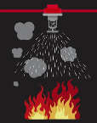
Essential Building Features
Automatic Suppression - automated action deployed to limit growth and/or extinguish a fire.
NFPA 13 System Required
  Coverage Throughout
Supervision Required
  Transmission Requirements - Zone Specific
  Annunciation Requirements
Notes:
Explain rationale for excluding 13R and 13D systems
Explain high-level basics of the acceptable suppression system
Explain rationale for required the supervision
How a facility can know if they have zoned water flow that matches the building fire plans

Slide 11
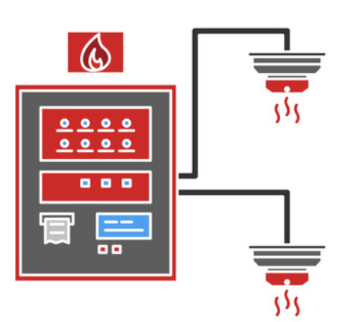
Essential Building Features
Fire Alarm System Requirements-
Pathway Survivability
  Level 2
    One or more 2-hour fire-rated (2h FR) circuitry integrity cable; 2h FR cable systems; 2h FR enclosure/protected hour; 2h performance alternatives approved by all AHJs
  Level 3
    Same as Level 2 with full NFPA 13 automatic sprinkler system
Notes:
-Define pathway survivability (The ability of any conductor, optic fiber, radio carrier, or other means for transmitting system information to remain operational during fire conditions)
-Explain purpose of requiring pathway survivability. (You are keeping vulnerable humans in a building on fire. Information about the fire and communication for first responders and occupants must be sustained.)

Slide 12
Essential Building Features
Fire Alarm System Requirements-
Transmission Capabilities (2010 NFPA 72 24.4.1.8)
  Requires selective, manual voice instructions to one or more zones
  Start/End tone bookends instructive messaging
  Message repeatability required
Stairwell speakers zoned separately
Requirements are for all audio and visual circuits
Notes:
-Explain required transmission capabilities
-Voice instructions must be available to select zone, zones and all zones
-Voice message must begin and end with an alert tone of 1-3 seconds duration
-Alert tone and messages must be repeated at least 3 times in the fire-affected zone to direct occupants to safety
-Stairwell speakers where provided are zone separately for manual paging only

Slide 13
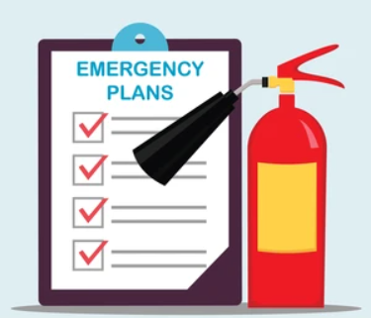
Emergency Plan
Must address components from 2012 NFPA 101 32.7 and 18.7
  Written plan must be available at all times
  Fire protection procedures required
  Special staff response including fire protection procedures required
  Resident training required
  Sufficient staff to implement plan and assist residents required
Notes:
(Bryan)
Time allowed for this presentation does not offer opportunity for in-depth consideration of this topic.
-The plan must address required components in 32.7 and 18.7.
-The plan must address the staff role in fire containment. (close doors to affected area)
-The plan must direct staff when and how to relocate residents within the building
-The plan must inform staff of location and methods required to relocate residents with special needs
(Ask what might be needed if the facility admits residents that use mechanical lifts or two-person assist for transfers)
-The plan should identify sufficient staff to assist residents based on the characteristics of residents (Think specific Resident Rating Sheets and building score)
-Assembly point for evacuation identified

Slide 14

Staff Training
Training Content
  Resident-specific response procedures as required by NFPA 101 with periodic updates as resident needs change
  When residents must relocate or remain in place
  Who will move residents requiring relocation
  Fire containment and alarm activation procedures
  Fire prevention procedures
Training Outcomes
  Staff can relocate or direct each resident to remain in place as appropriate
  Staff can activate alarms
  Staff can confine fire
  Staff can enact a full evacuation as needed via all exits
Notes:
In a Large RBC staff training must:
-Inform staff of the location and assistance requirements for those residents who can not independently follow alarm instructions. Training must be updated as resident needs change or as new residents with special needs are admitted. At hire and annual training is insufficient.
-Training must be updated as resident conditions change
-Staff know relocation routes and exit routes for each smoke compartment

Slide 15

Drill Requirements
Reviewed as Large Residential Board and Care (NFPA Chapter 32)
  Drills occur bi-monthly with 2 sleeping hours drills yearly
  Use all exits and means of escape
  Staff must be on duty to assist
  Actual evacuation to of all residents to an assembly point as specified by emergency plans
  “Impractical” or physically unable residents are exempt from drills
Reviewed as Health Care (NFPA Chapters 18/19)
  Drills occur once per shift per quarter
  Removal of all occupants directly involved in fire emergency
  Transmission of appropriate fire alarm signal
  Confinement/isolation of fire effects
  Resident relocation per fire safety plan
Notes:
All facilities using defend in place meet specified drill requirements. Defend in place facilities must:
-Complete monthly drills (impractical/unable residents exempt) on various shifts with various fire scenarios
-Develop and maintain emergency plans directing staff how to relocate and evacuate residents to an assembly point
-Direct staff how contain fire following emergency plan

Slide 16

Resident Education
Residents must be educated on:
Proper actions in the event of a fire
What to do if primary escape route is blocked
Training on helping others to the extent of their abilities
Facility rehabilitation/habilitation programs include fire prevention and actions to be take in a fire
Notes:
Residents must receive training on how to respond when the fire is and is not in their smoke compartment. This means an education tailored each resident.
They should know what to do if their usual egress path is obstructed.
Those who are able must be taught how to help others when safe to do so.
If your facility offers or operates a rehabilitation/habilitation program, it must include fire prevention and actions to taken in the event of a fire.

Slide 17

Fire Prevention
Controlling ignition sources
Maintaining equipment and systems
  Higher risk locations (kitchens, storage)
  Higher risk equipment (oxygen, heat source)
  Combustible materials (smoking, hazardous type)
Malfunction/problem reporting mechanism
Education for staff and residents
Notes:
Total concept includes Fire Prevention
-Safety rounds focusing on the highest risk areas. Per NFIRS Facility fires start involve cooking (71.3%), electrical appliances/heating/electrical malfunction (9.5%)
-Be attentive to high-risk storage and oxygen use
-Consider ways to improve safety with high-risk activities like smoking and cooking
-Consider developing mechanism for reporting concerns in malfunctioning devices or other items that present a fire risk
-Education for staff on when to report problems that can lead to fire (space heaters, extension cords/plug extenders, malfunctioning devices, residents smoking in rooms, natural gas odor)
-Education for residents on how they can keep the community safe

Slide 18

Jurisdictional Consensus
Formal written authorization from the fire code official or local responding fire department validating the strategy’s viability within the jurisdiction.
Local fire department’s likely approval considerations:
  Their response sufficiency
    Their staffing availability
    Their equipment availability
  Your staffing, resident census & conditions, building, policies
Notes:
DFPC will require jurisdictional consensus to approve DIP in any large ALR.
We are not the responding agency.
We work with your local jurisdiction to understand what DFPC will review and verify for defend in place.

Slide 19
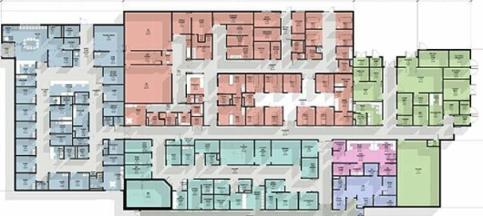
Request DIP Review
Professional Analysis
Permit Application
  Jurisdictional consensus agreement
  Building and system plans
  Emergency plans
Review & Issuance
Site Verification
Ongoing Maintenance
Notes:
DIP approval will be obtained through the same process as a typical permit.
Providers will need a analysis from a credentialed design professional.
Plans for applicable building systems including smoke compartments, egress, fire alarm, and suppression system.
The emergency plans will need to be submitted for review along with evidence of jurisdictional consensus.
Buildings that meet the technical and system requirements will receive a defend in place status.
Status can be removed should the facility fail to maintain processes and systems.

Slide 20
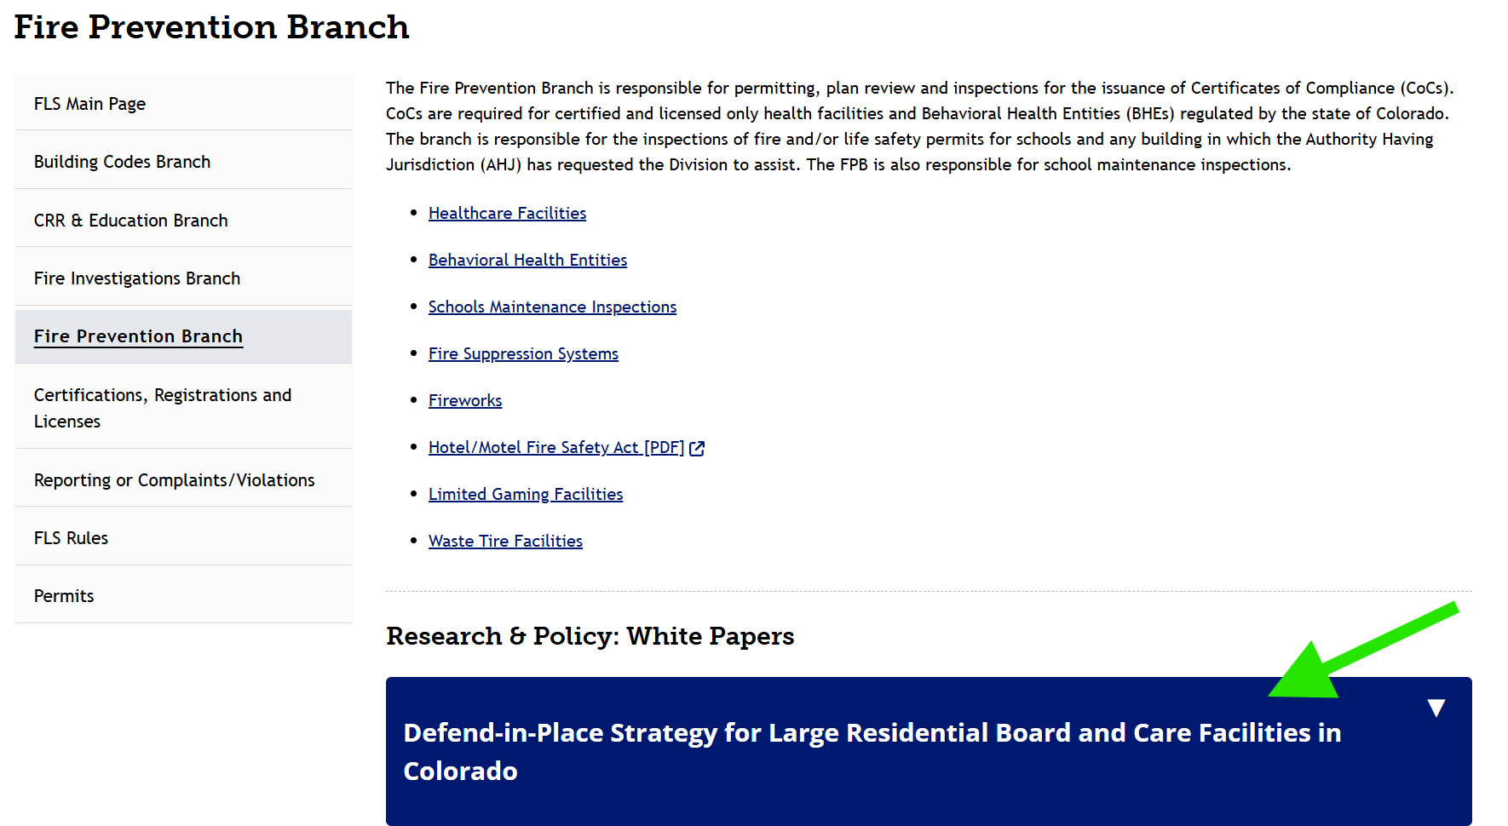

Defend in Place White Paper
https://dfpc.colorado.gov/sections/fire-life-safety/fire-prevention-branch
Notes:
Please download and review the Defend in Place White Paper on our website. It provides specific information, applicable code references, and the checklist of documents required for the defend in place review. You will see banner at the bottom of the page where you can complete the download.

Slide 21
Questions?

Slide 22





Thank You.
Craig Montoya
720-512-7802
craig.montoya@state.co.us
Shannon St. Hilaire
720-618-0620
shannon.st.hilaire@state.co.us
Bryan Adams
720-921-7535
bryan.adams@state.co.us
https://dfpc.colorado.gov/FLS

