Slide 1
Beyond Balance: An Interdisciplinary Approach to Fall Prevention in Assisted Living
Jordon Allard, MOT, OTR/L | Ben Black, PT, DPT | Erin McGrady, MS CCC-SLP
LeadingAge Conference
September 17, 2026

Slide 2
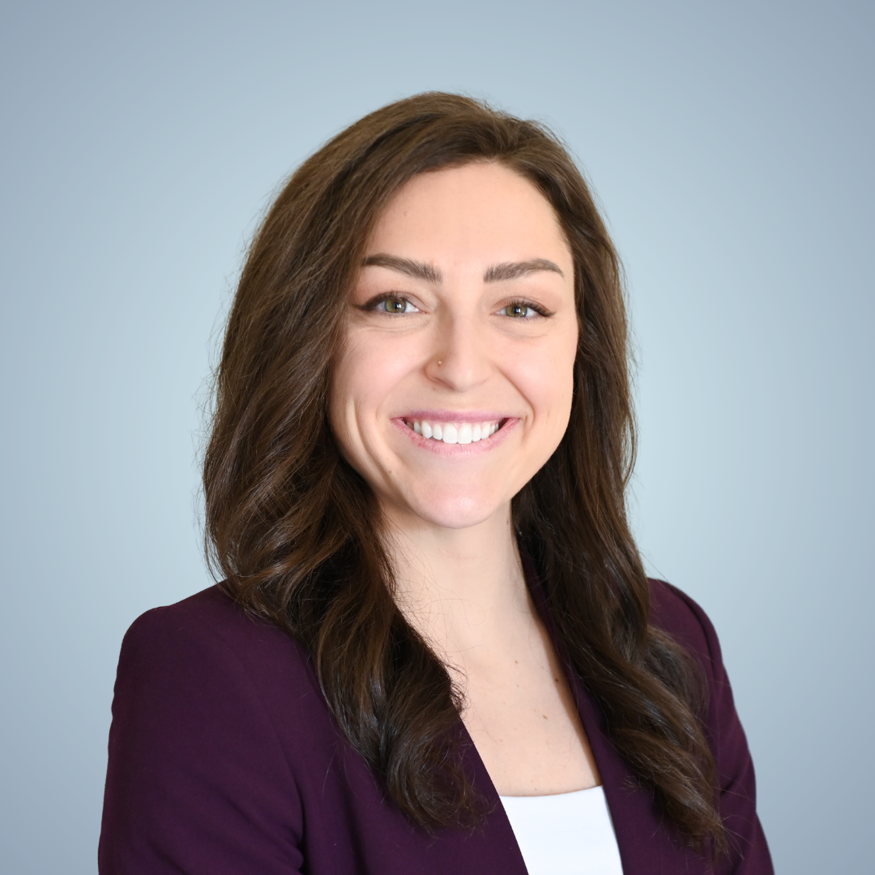


Introduction
Jordon Allard, MOT, OTR/L
Ben Black, PT, DPT
Erin McGrady, MS, CCC-SLP
Founder, CEO
Director of Clinical Operations
Lead Therapist

Slide 3
Learning Objectives
Apply practical systems to improve resident safety and interdisciplinary collaboration to reduce falls.
Recognize early changes in resident function that may warrant therapy assessment or intervention for fall prevention.
Role of PT, OT, and ST in fall prevention

Slide 4
Senior Living Uniqueness
Size and levels of care within community (IL, AL, MC, SNF)
Targeted demographic
Staffing models
Provide the best resident experience
  Falls can negatively impact not just resident’s quality of life, but the overall experience of the community

Slide 5

Fall Prevention Journey
Systems of a Fall Prevention Program
OT Fall Prevention Strategies
Case Study Outline
Q & A
PT Fall Prevention Strategies
ST Fall Prevention Strategies

Slide 6
Fall Prevention Journey
Systems of a Fall Prevention Program

Slide 7
"You do not rise to the level of your goals.
You fall to the level of your systems"
– James Clear

Slide 8
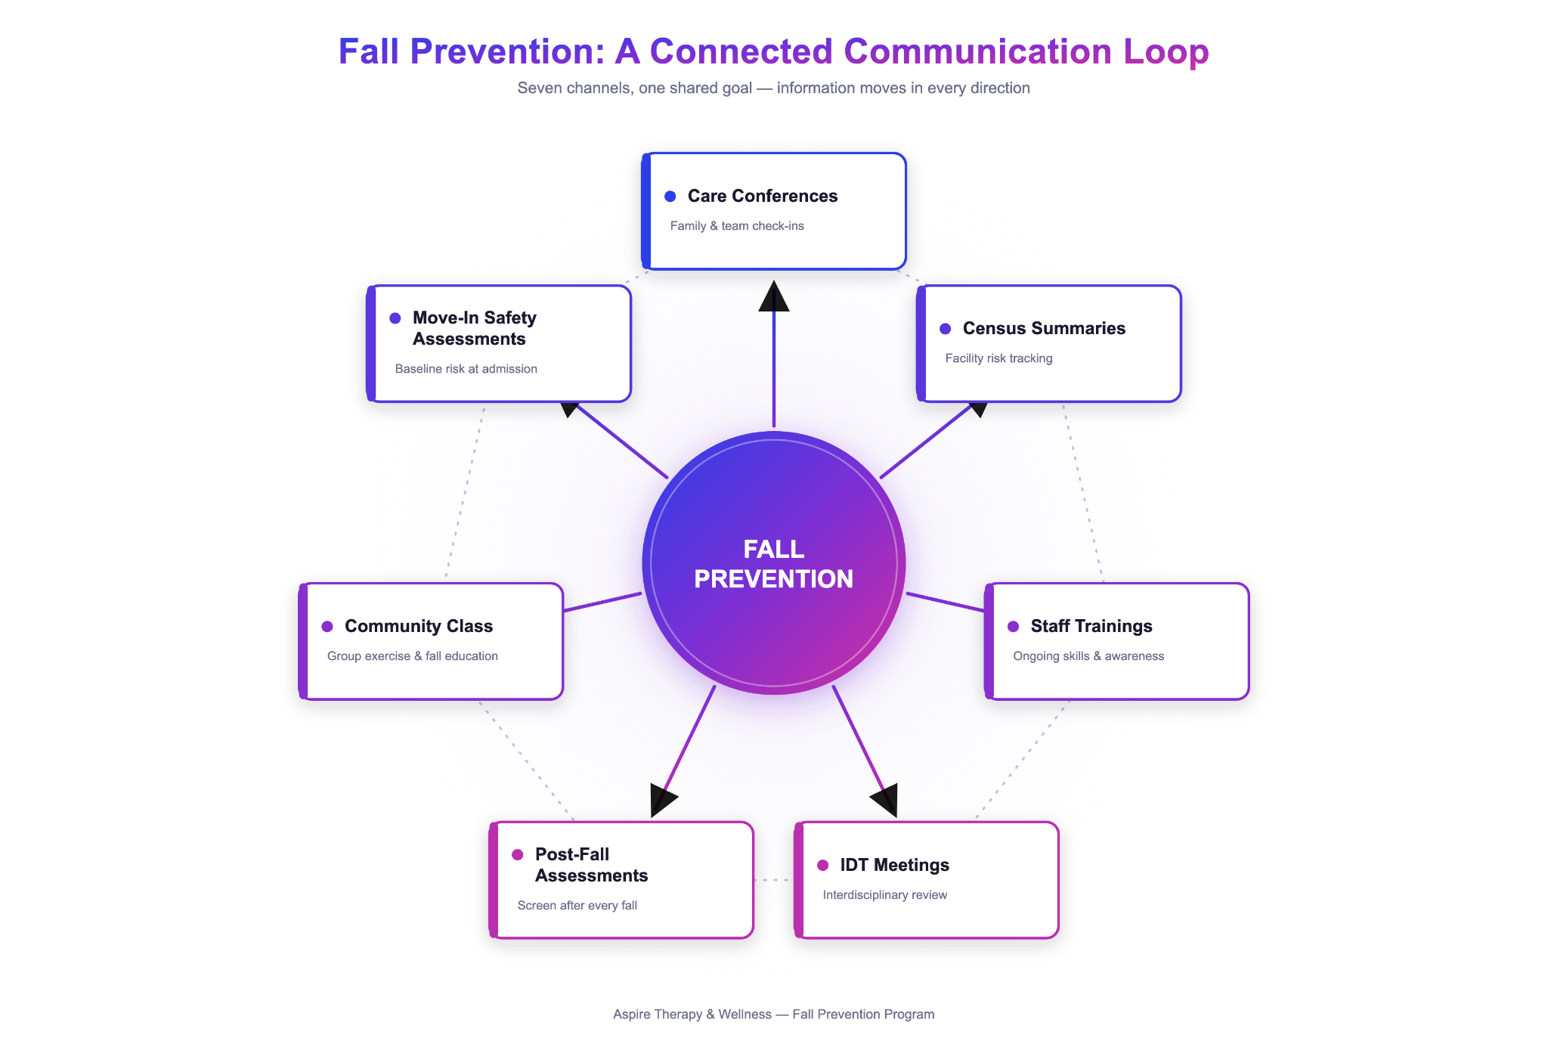
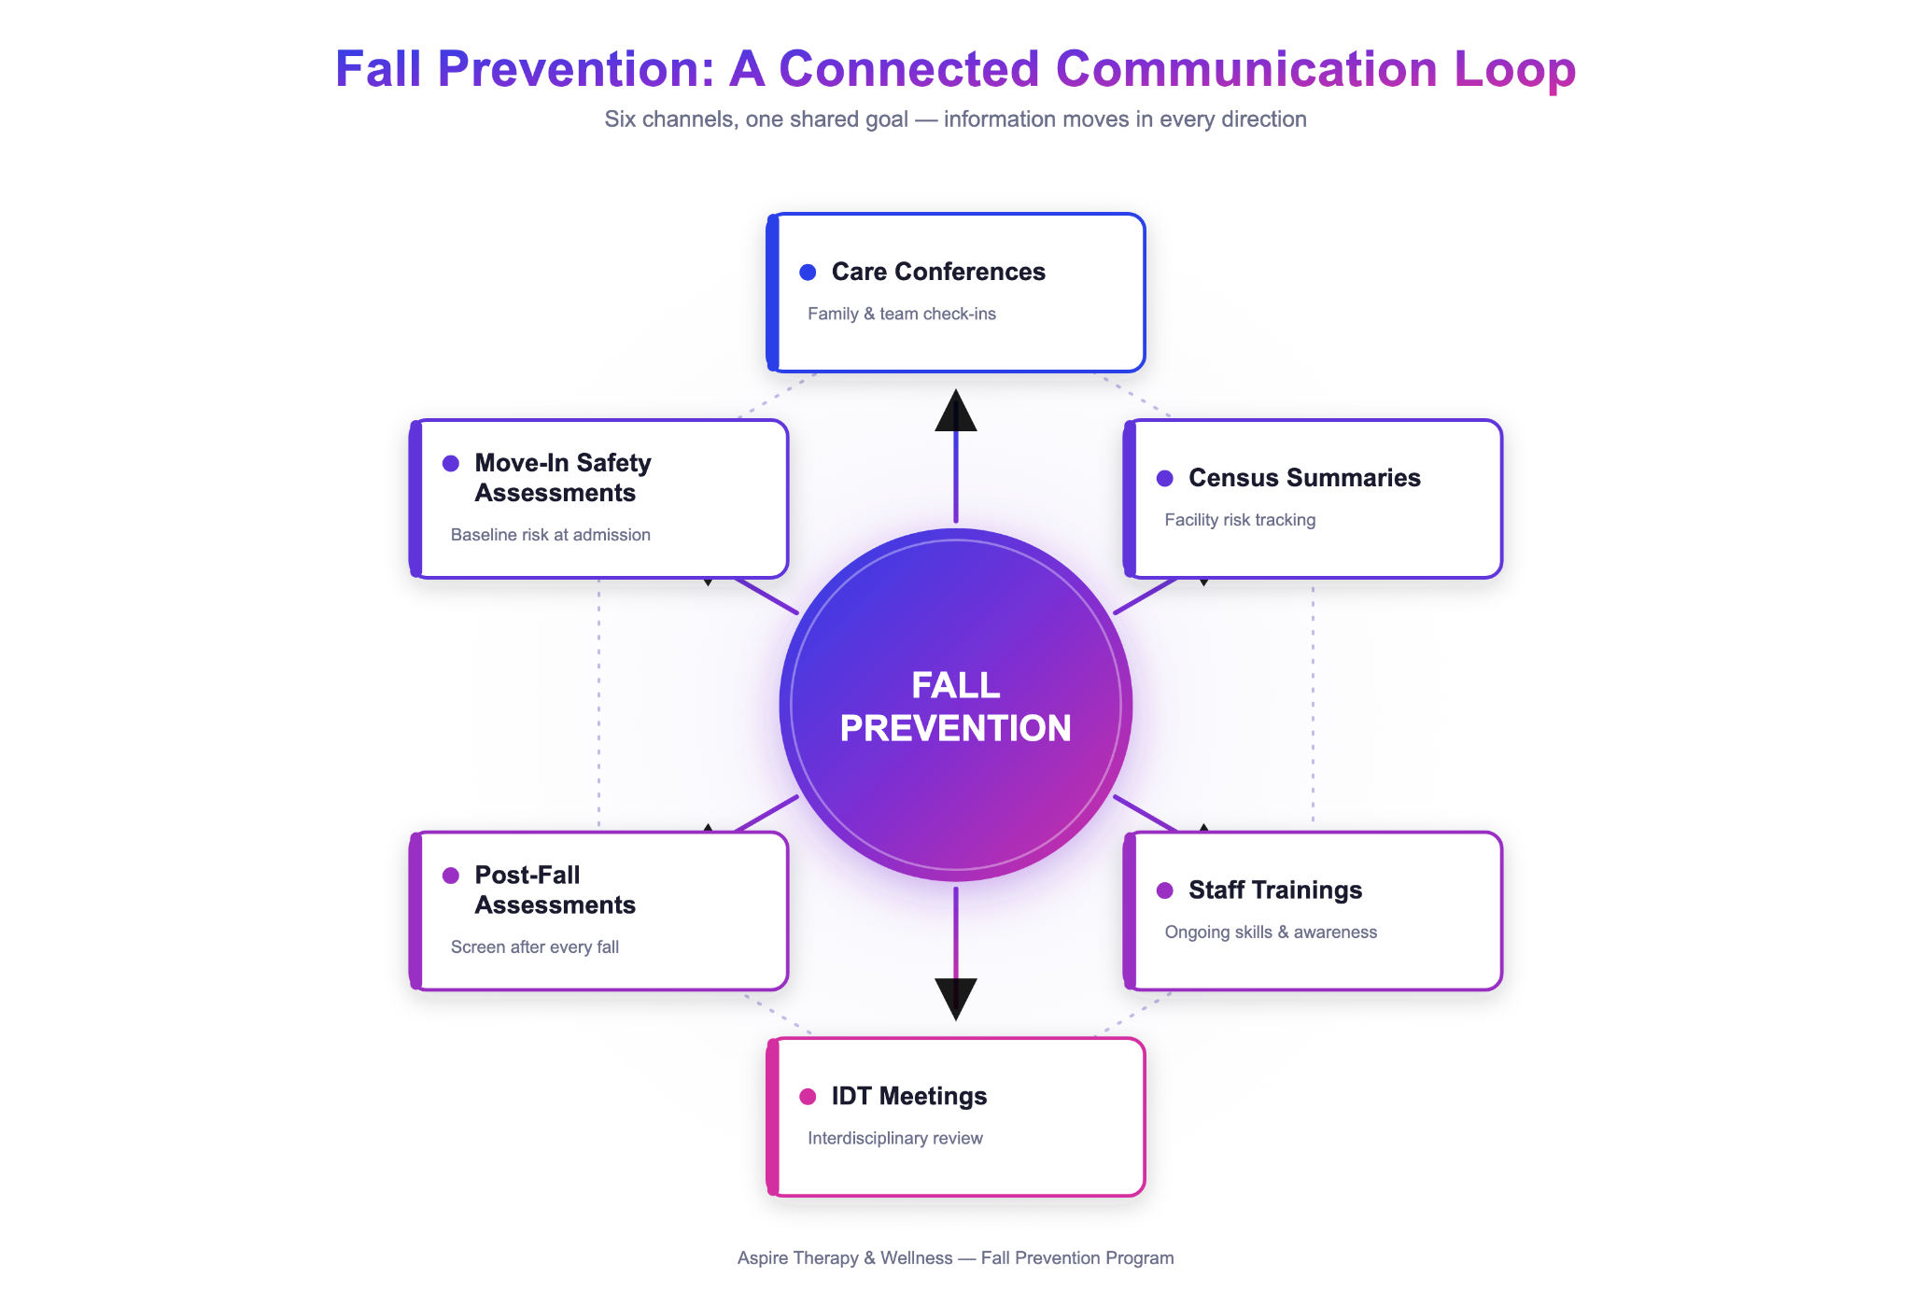
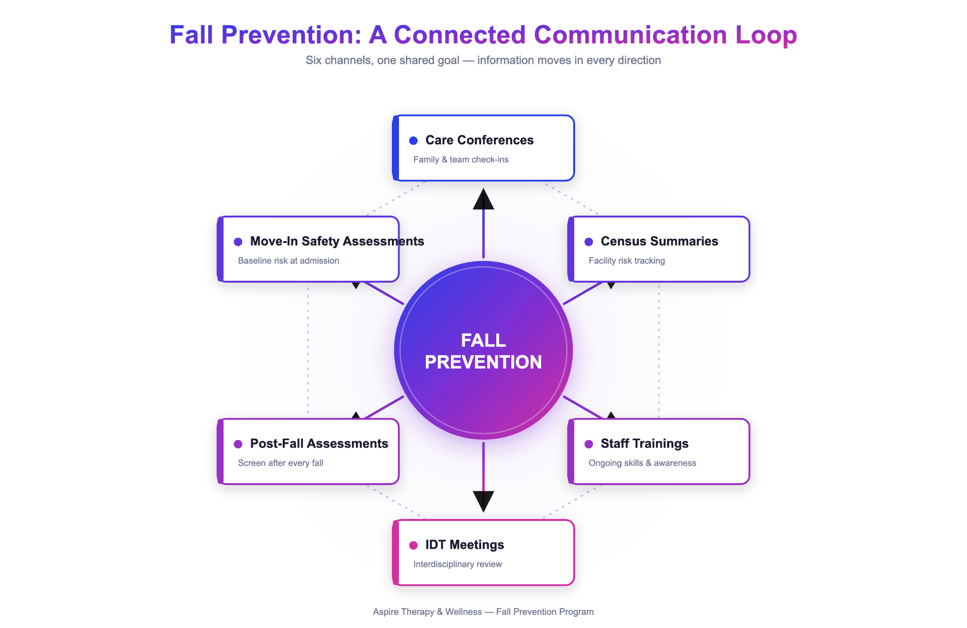
Notes:
How these 7 systems work together for the overall goal of keeping residents safety and preventing falls

Slide 9
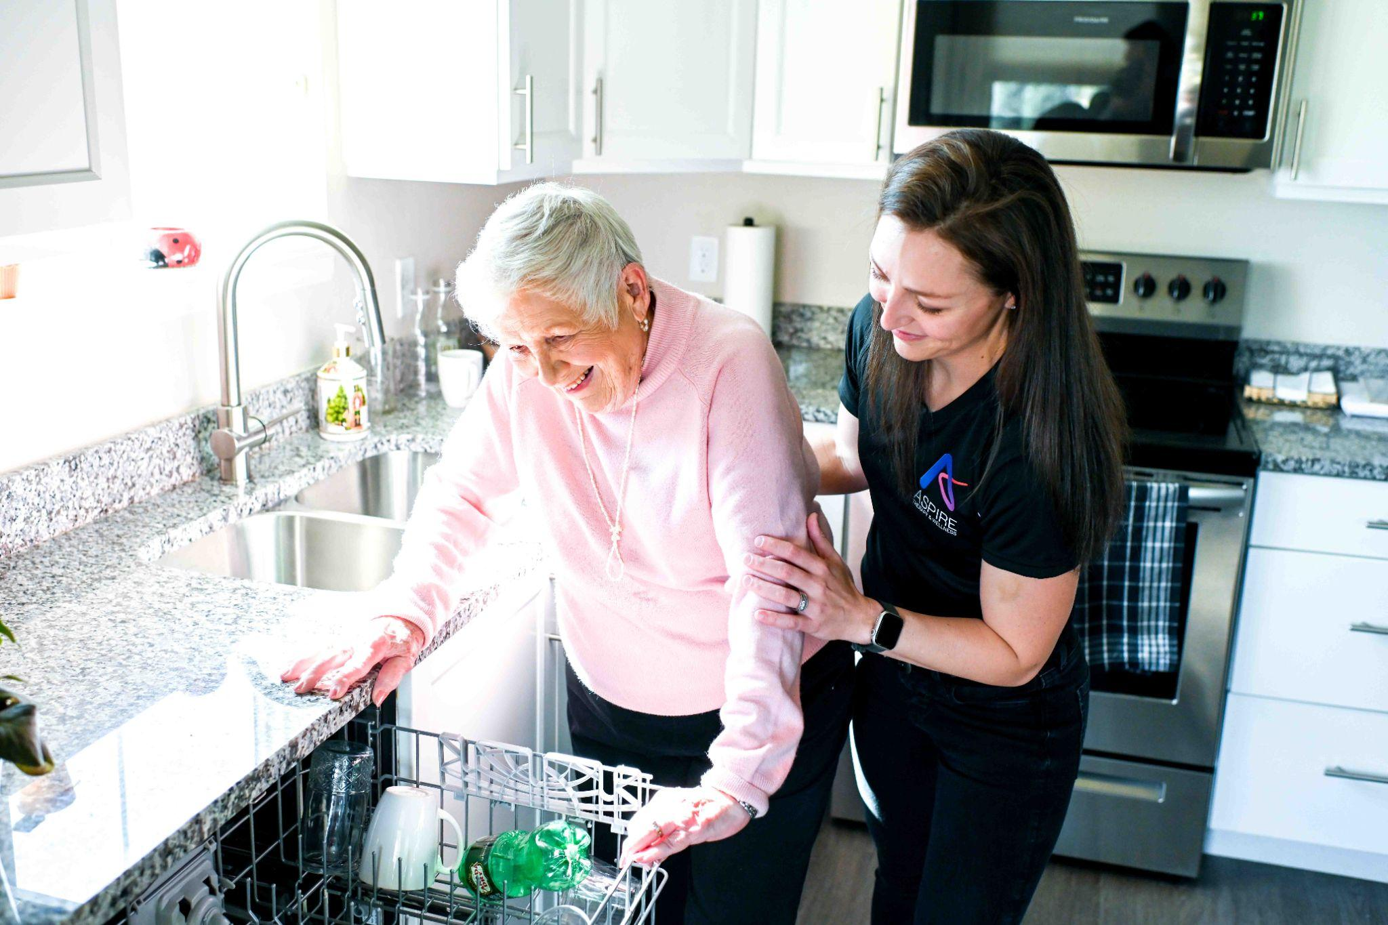
Fall Prevention Systems
1
Move-in home safety assessment
Initiation is resident specific
Best practice is within 2 weeks of move in
  Furniture adjustments
  Equipment needs
  Safety education
Baseline function
Collaboration with community
Setting expectations early in the relationship from sales
Much better receptiveness if resident/family is prepped prior

Slide 10
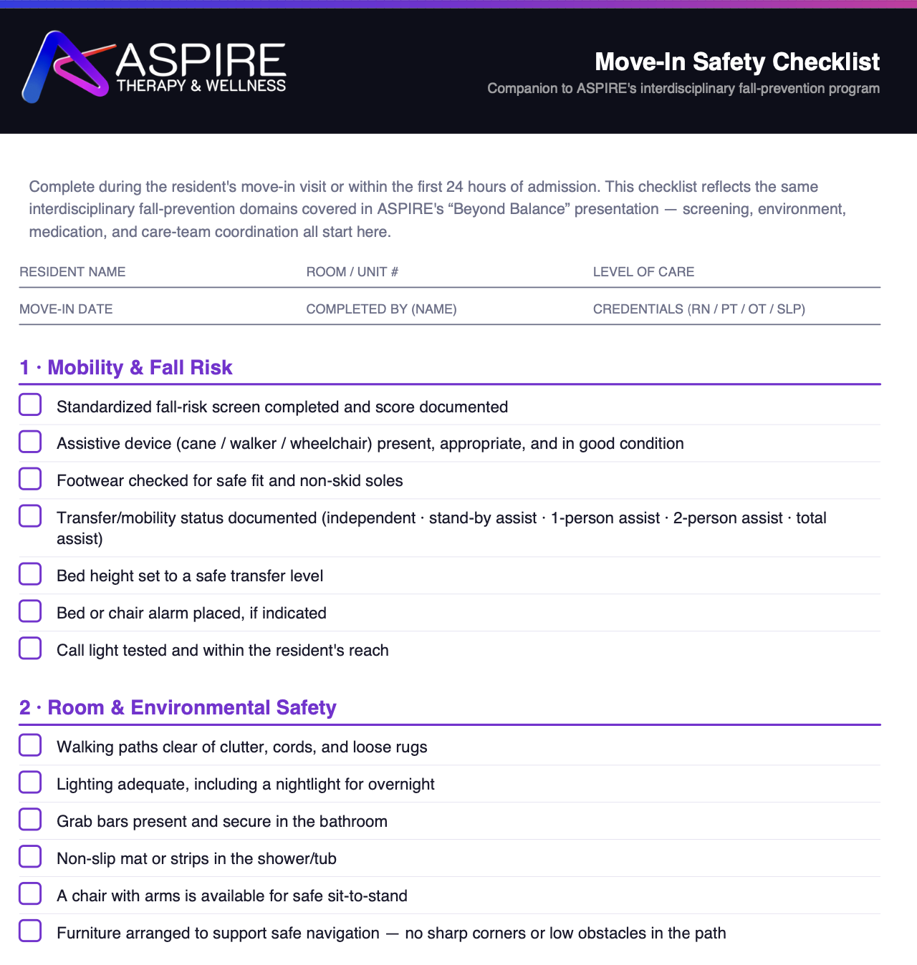
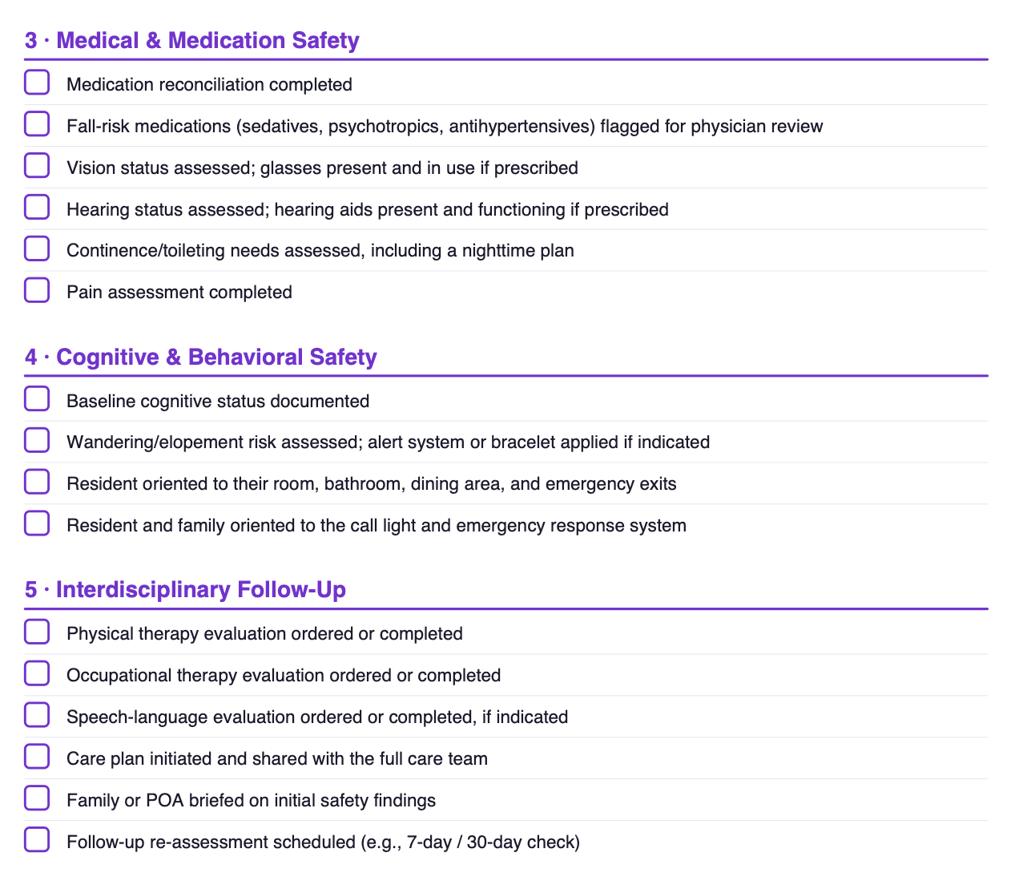
1
Therapy & nursing
PT
ST
OT
Notes:
Nurses are amazing and they can assess many of these things…nurses are also extremely busy, so leaning on therapy when someone moves in can be highly beneficial
Splitting up these domains is also highly beneficial within the therapy disciplines as well. There can be a lot of overlap here, for example, PT and OT can both assess the environment, OT and ST can both assess cognition. But when multiple disciplines are involved it allows us to spend more time on certain things.

Slide 11
Fall Prevention Systems
2
Interdisciplinary team meetings
Cadence depends on size of facility and volume of residents on caseload
  1-5x/week
  ASPIRE average: 3x/week
In person meeting to review
  New move-ins
  Therapy concerns (fall risks)
  Changes in status
  Referrals
For communities that offer multiple care levels, consider a “Next Steps” meeting
  Discuss high-risk residents who may benefit from higher level of care

Slide 12
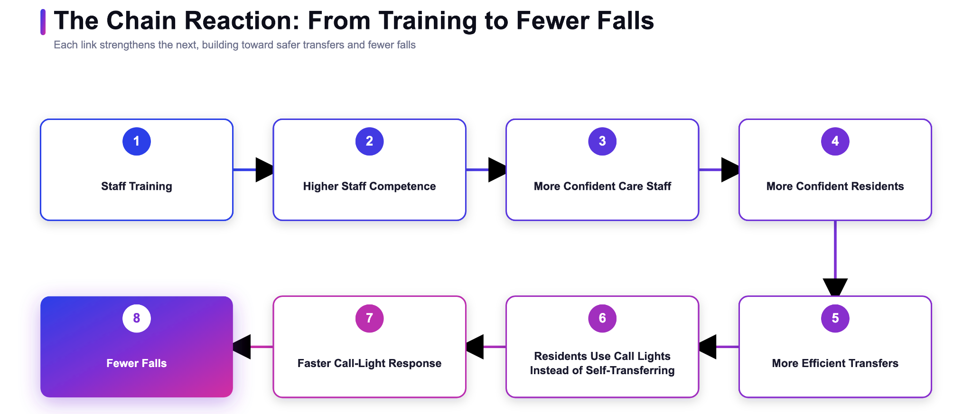
3
Staff Training
An empowered staff produces better outcomes

Slide 13
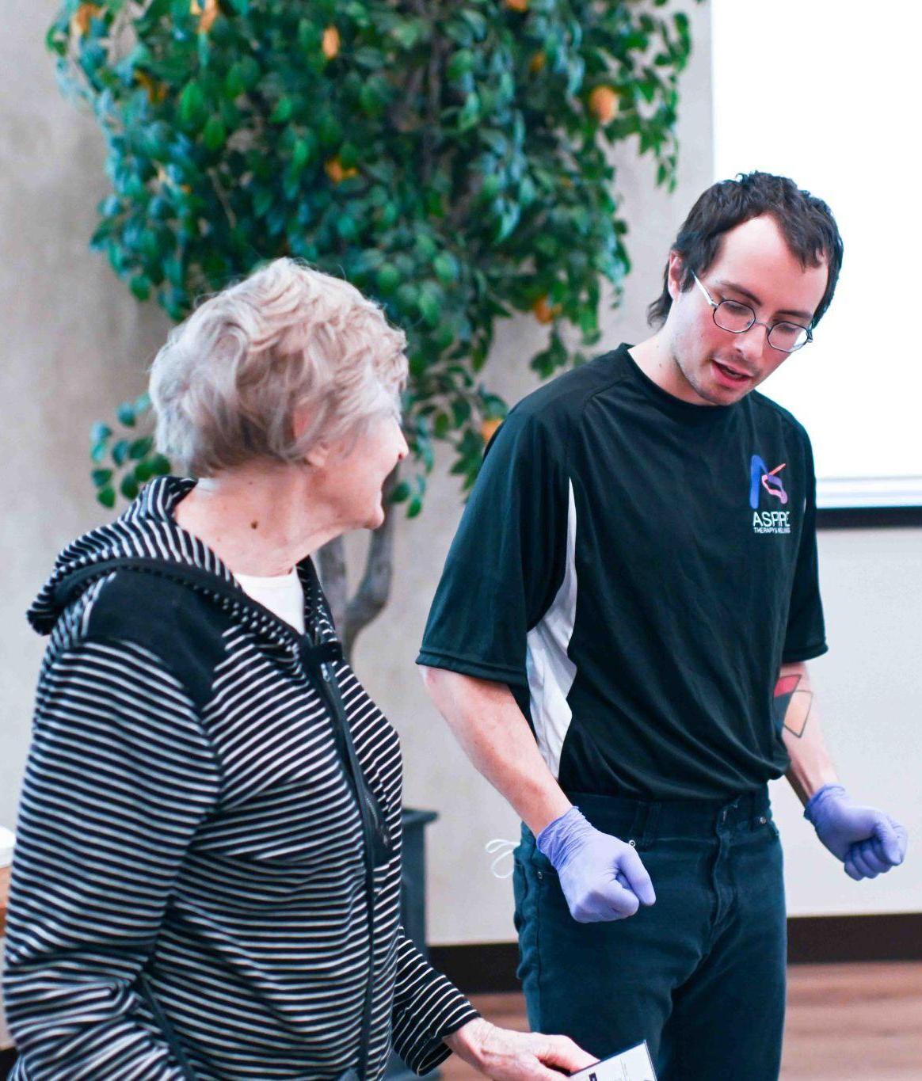
Fall Prevention Systems
3
Staff Training: Type #1
Regular Cadence of Trainings
Weekly, bi-weekly, monthly, quarterly – what does your community need?
Safe transfer strategies
  Reduce staff injury → increase confidence
Mechanical lift training
Parkinson’s Disease
Safe walker and wheelchair use

Slide 14
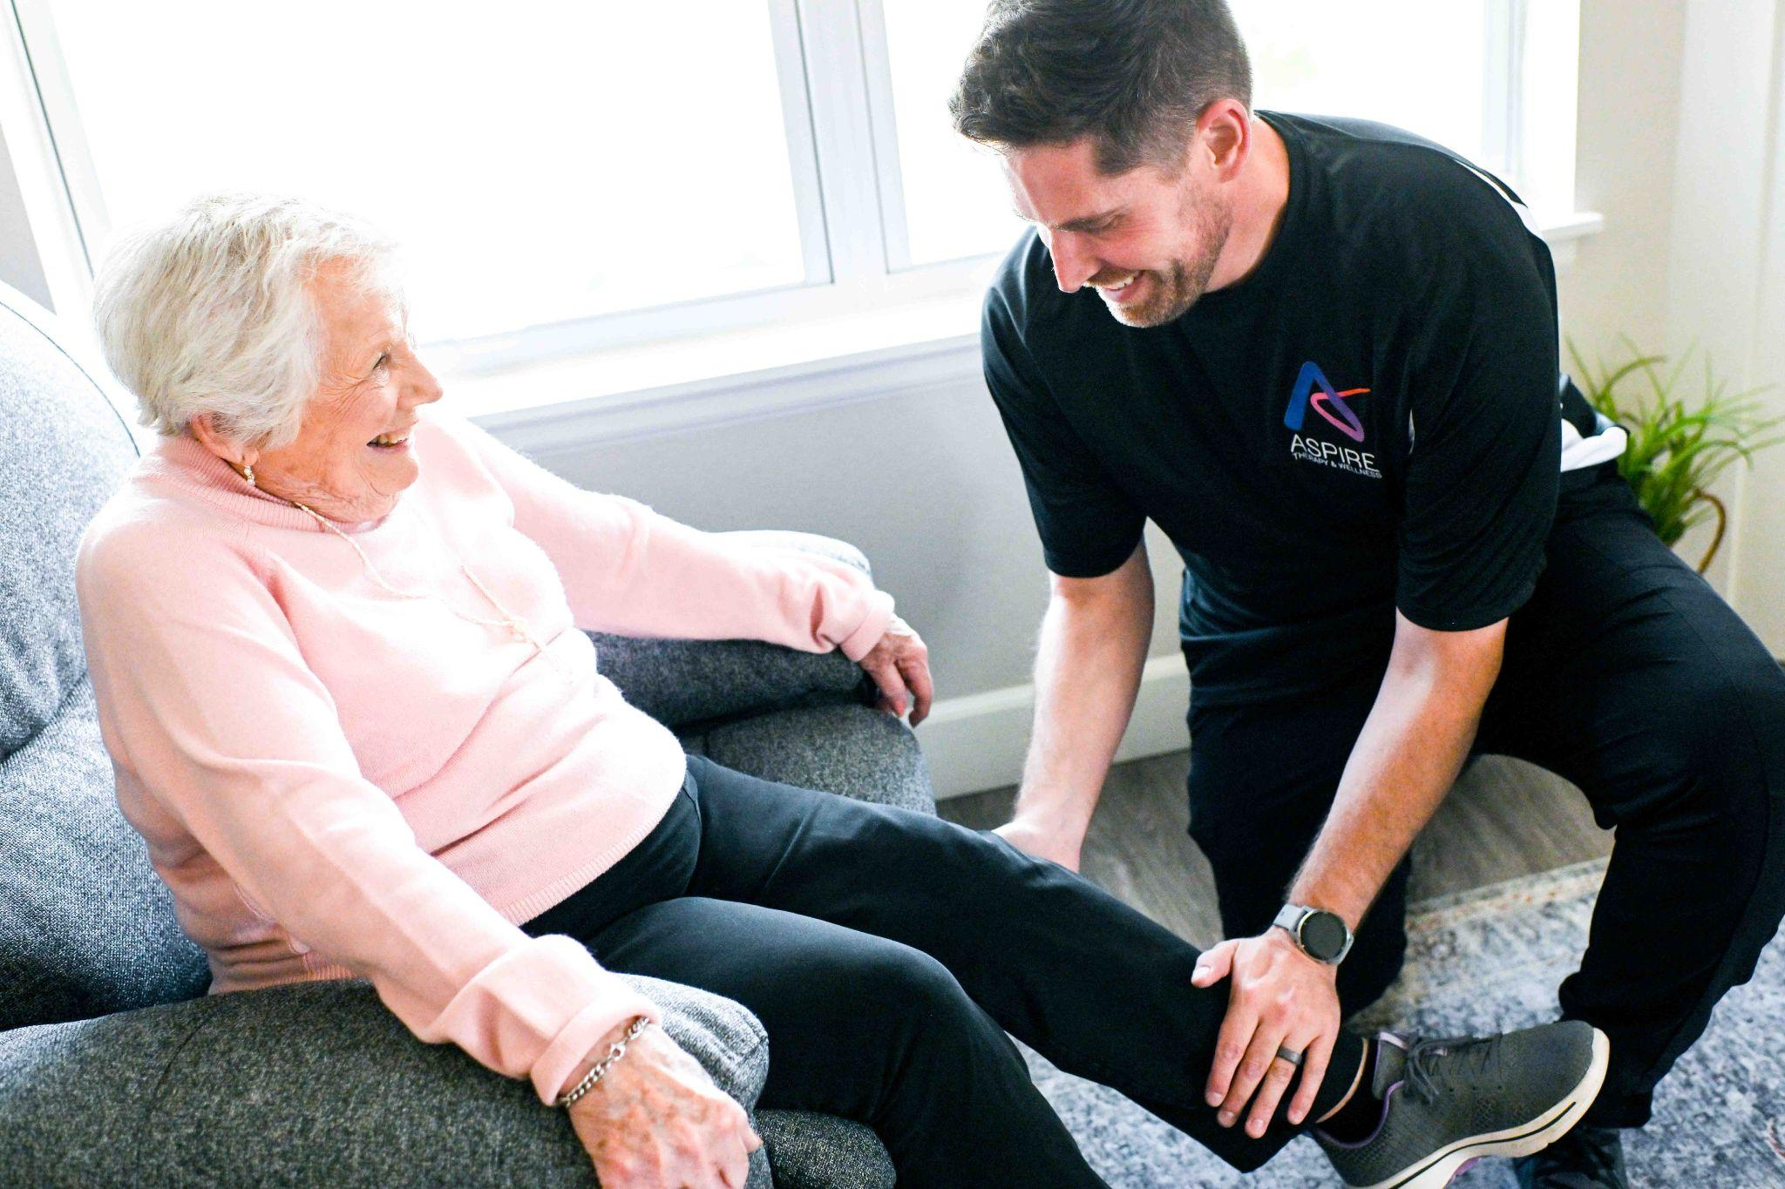
Fall Prevention Systems
3
Staff Training: Type #2
Training During Therapy Sessions
Resident-specific training for more complex transfers
Complicating factors
  Cognitive deficits
  Communication barriers
  Weight bearing precautions
  Lifts or braces involved
  Heavy assistance
  Fear of falling

Slide 15
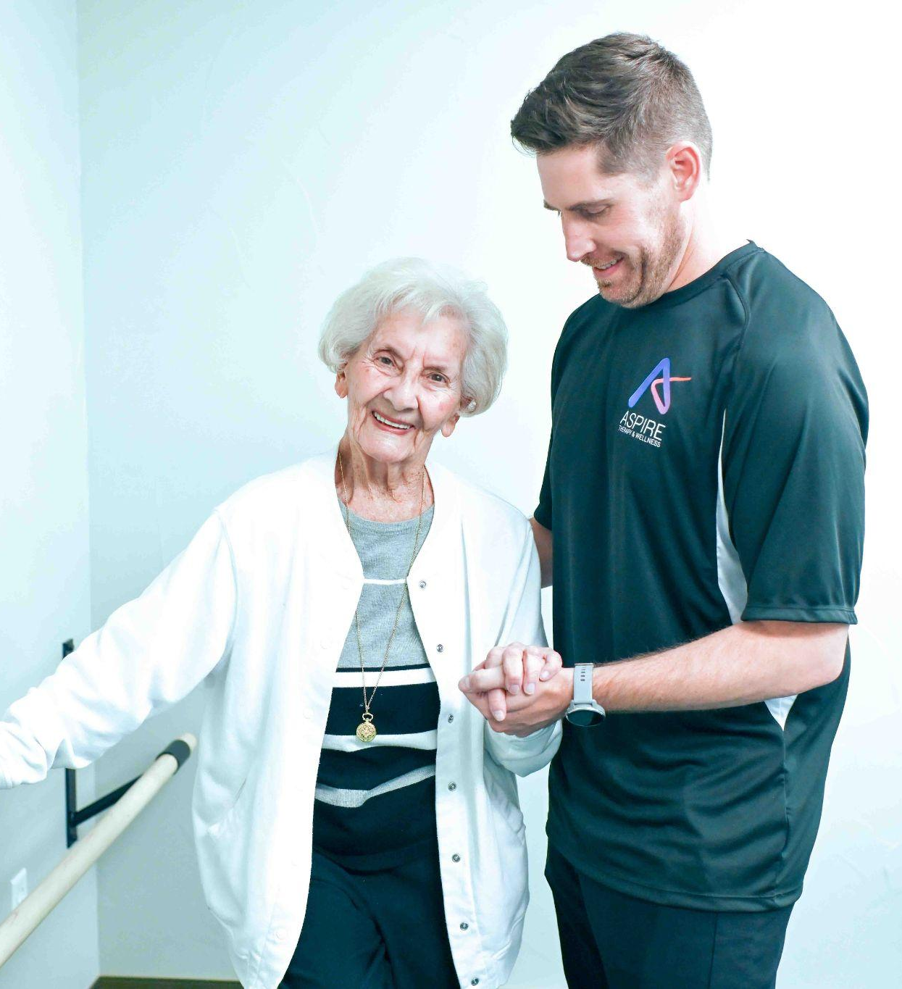
Fall Prevention Systems
4
Care Conferences
30 days after move in, plus…
As needed
  Decline in function
  Potential change in setting
  Return from hospital
Benefits of therapy attending
  “Meeting before the meeting”
  Uniform & consistent recommendations
  Reinforcement of fall precautions and safety strategies
  Updates

Slide 16
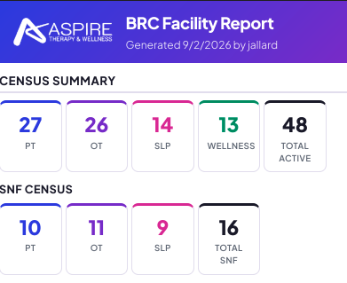
Fall Prevention Systems
5
Census Summary Report
Weekly cadence
Provides facility staff with high level of transparency – who is being seen by therapy?
Avoid information overload from EMR documentation
& not enough information with paper forms
Multiple staff have access (paper forms live in one binder)
Customization to facility needs (1 patient per sheet for filing, for example)
Notes:
JORDON

Slide 17
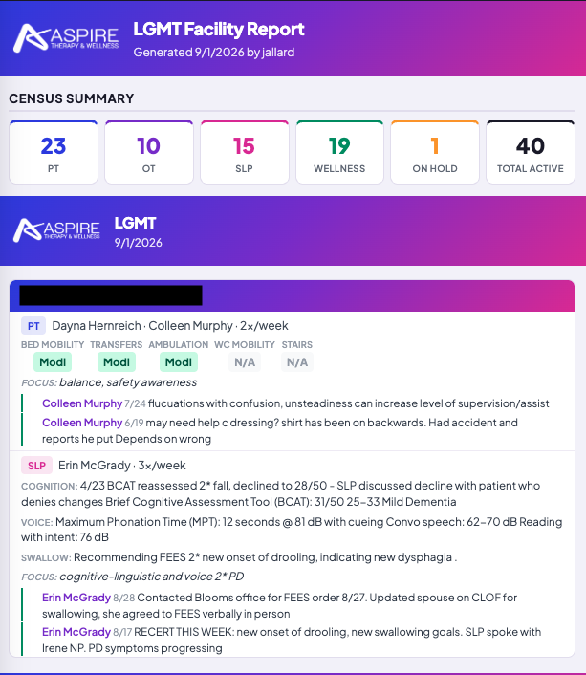
Fall Prevention Systems
5
Census Summary Report
Quick reference guide when something comes up or family calls
Therapists treating
Disciplines involved
Frequency
Interventions
Pertinent updates, safety recommendations, fall precautions
Therapy ensures compliance (not facility with paper forms)
Notes:
JORDON

Slide 18
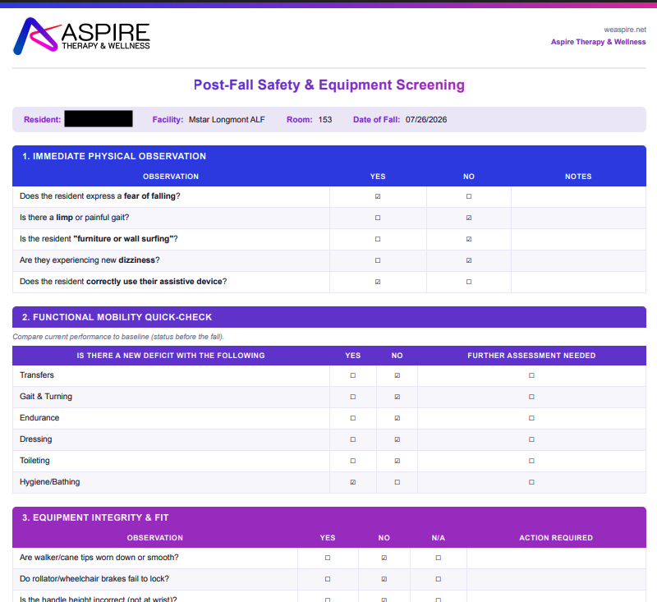
Fall Prevention Systems
6
Post-fall Assessment
Completed within 48 hours of fall
Sent electronically for ease of filing
Strengthens QA Program

Slide 19
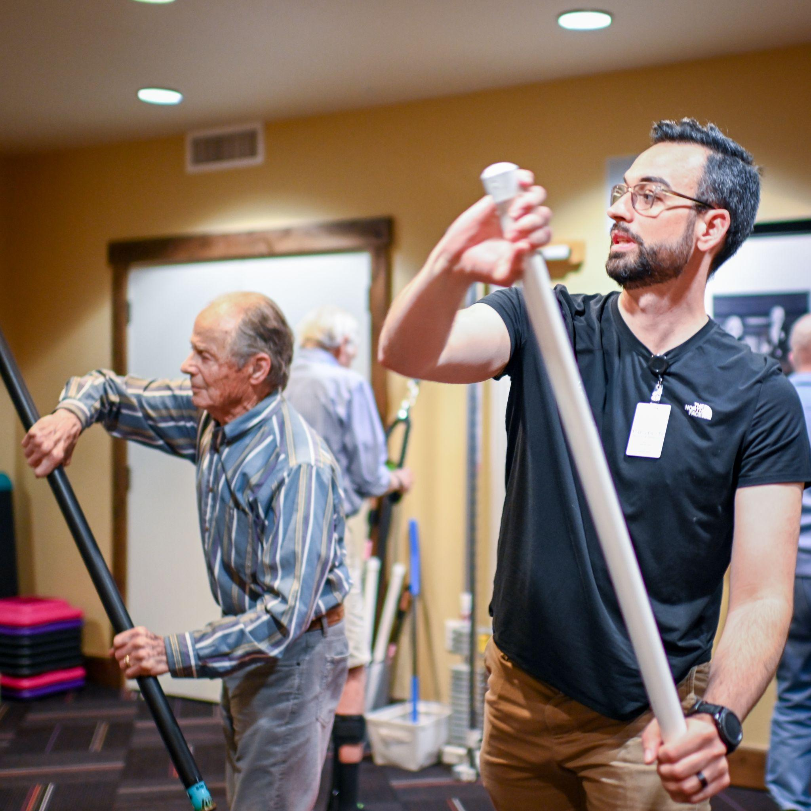
Fall Prevention Systems
7
Community Classes
1 weekly class from therapy
Tailored to community’s needs
  High level strength and balance
Another point of reference for eyes on residents
Trained life enrichment staff to continue class

Slide 20
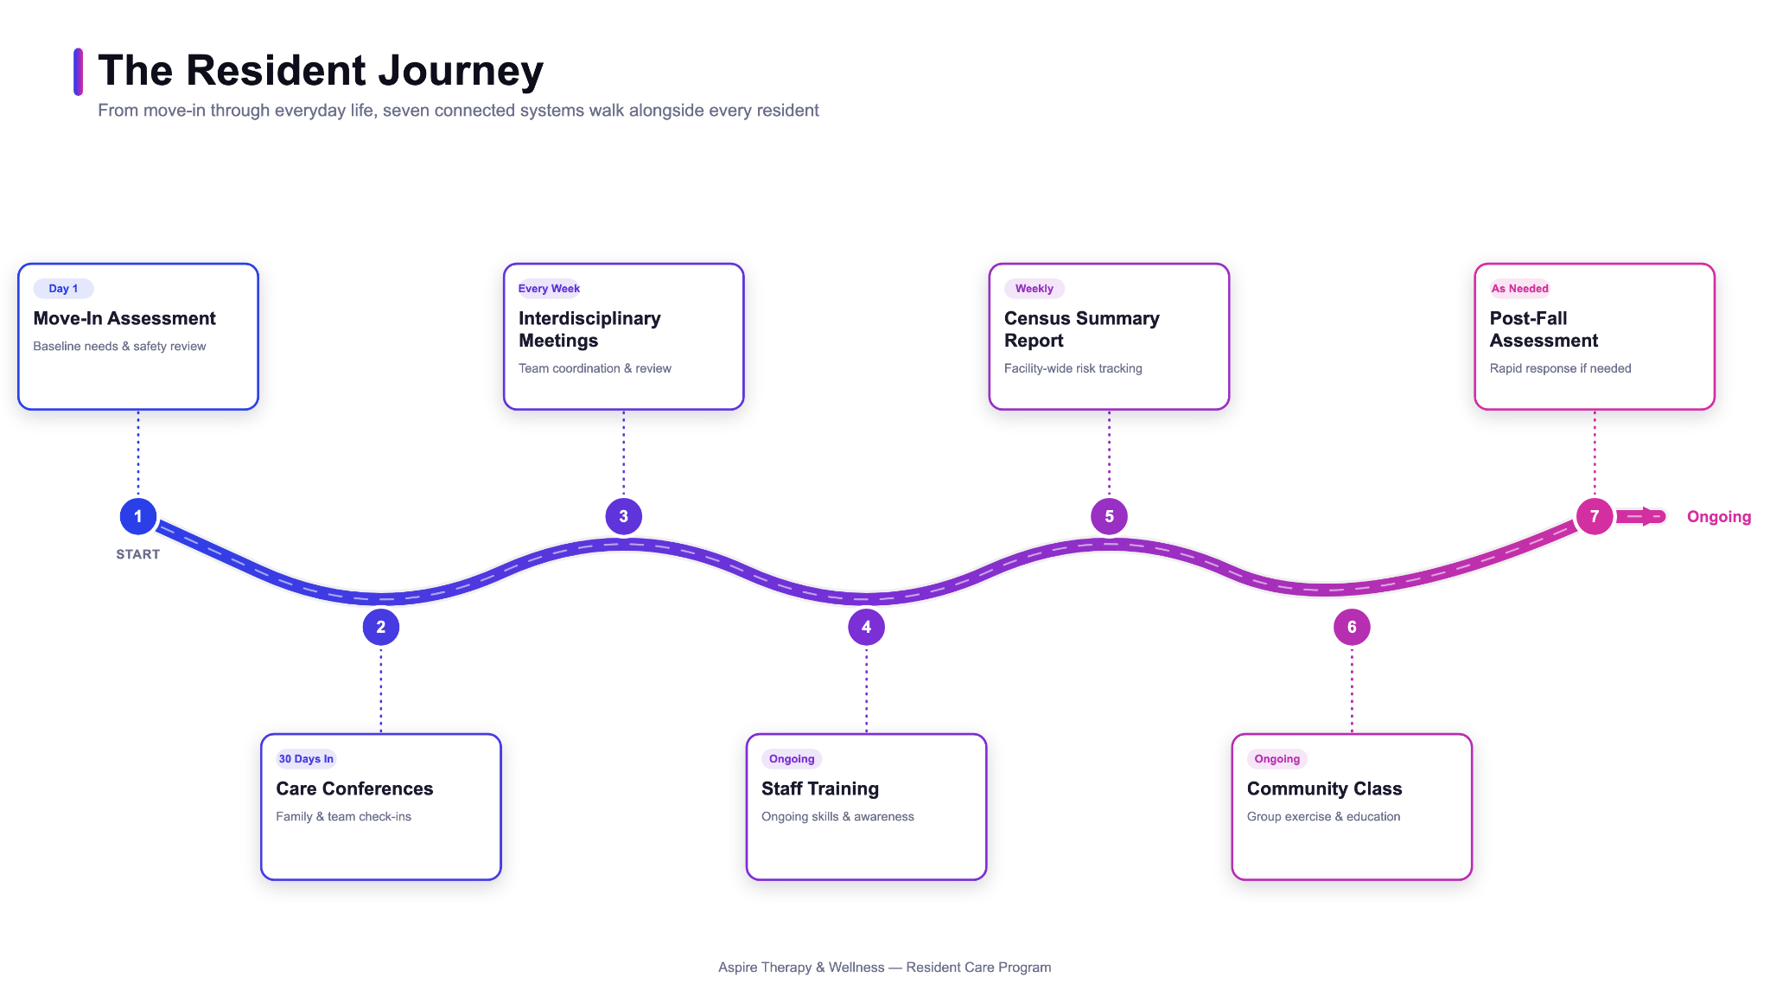

Slide 21
Fall Prevention Journey
Systems of a Fall Prevention Program
Case Study

Slide 22
Case Study: Patty
Large senior living community with multiple IL/AL buildings, MC, and SNF on one campus
Patty was a 78 y/o woman who moved into the community’s independent living 3 years ago.
Independent living staff recognized she started to have more difficulty transferring in and out of the dining room chairs.
  Concerns were discussed during the “Next Steps” meeting with therapy.
Patty was agreeable to a PT evaluation.
Notes:
BEN TAKES THIS SLIDE

Slide 23
Fall Prevention Journey
Systems of a Fall Prevention Program
Case Study
PT Fall Prevention Strategies
Notes:
JORDON TAKES SLIDE

Slide 24
Physical Therapy Findings
Patty had been increasingly reliant on use of an electric wheelchair over the past year, and had experienced unreported falls in her apartment, luckily without injury.
She was having increasing difficulty with attending to her hygiene and performing transfers from her recliner, toilet, shower.
Patty preferred a sedentary lifestyle, with her main hobby identified as reading romance novels.
She did not show concern about her safety/appropriateness for being in Independent living setting.
Soft Voice, difficult to hear at times in communal spaces

Slide 25

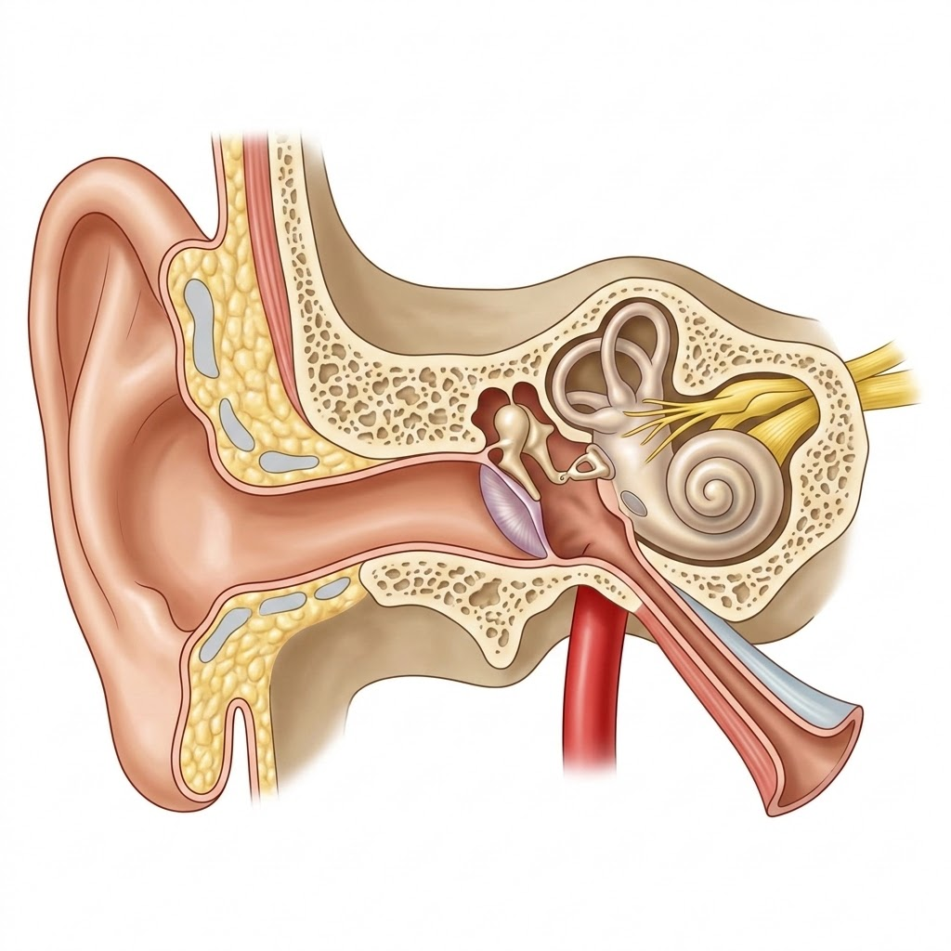

Physical Therapy Interventions - Balance
Vision
Vestibular
Proprioception
~ 50%
~ 25%
~ 25%

Slide 26
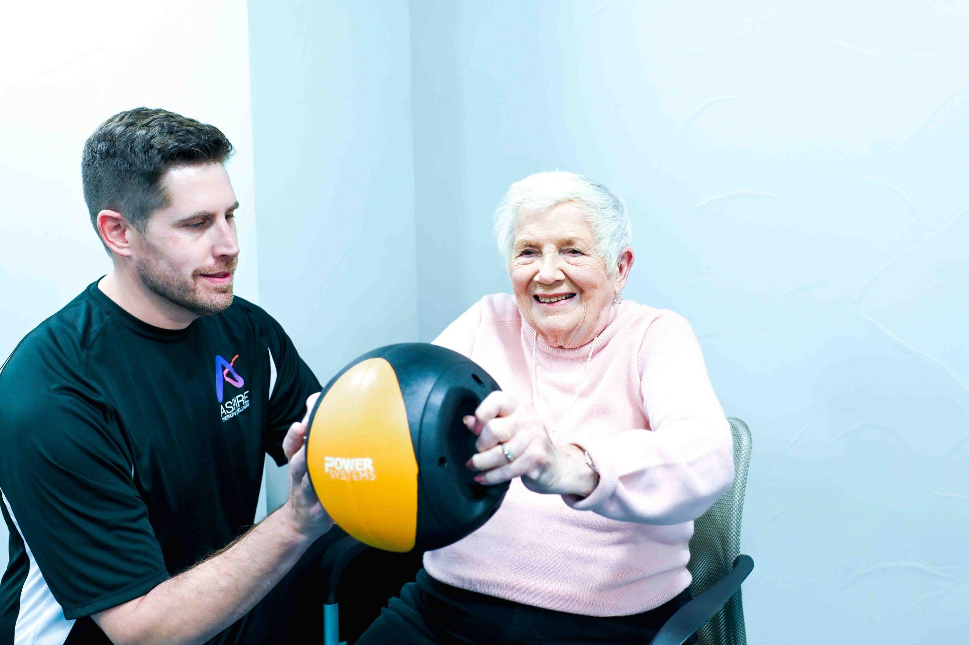
Physical Therapy Interventions - Strengthening

Slide 27
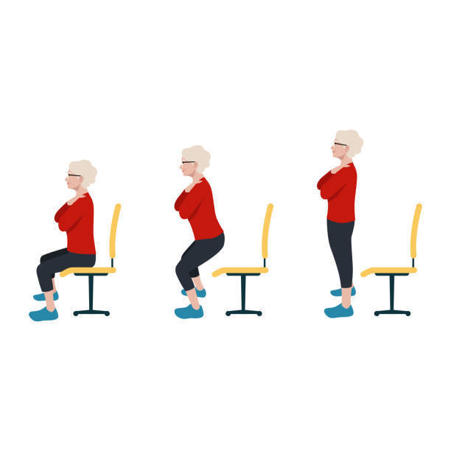
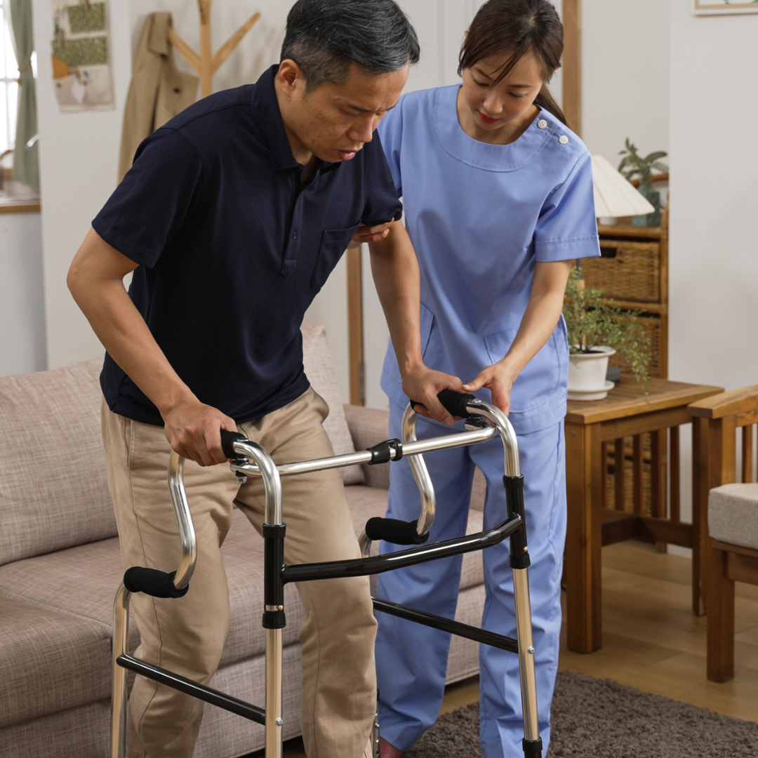
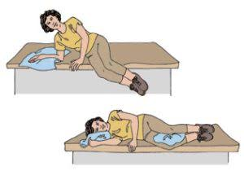
Physical Therapy Interventions - Mobility
Bed Mobility
Transfers
Ambulation

Slide 28
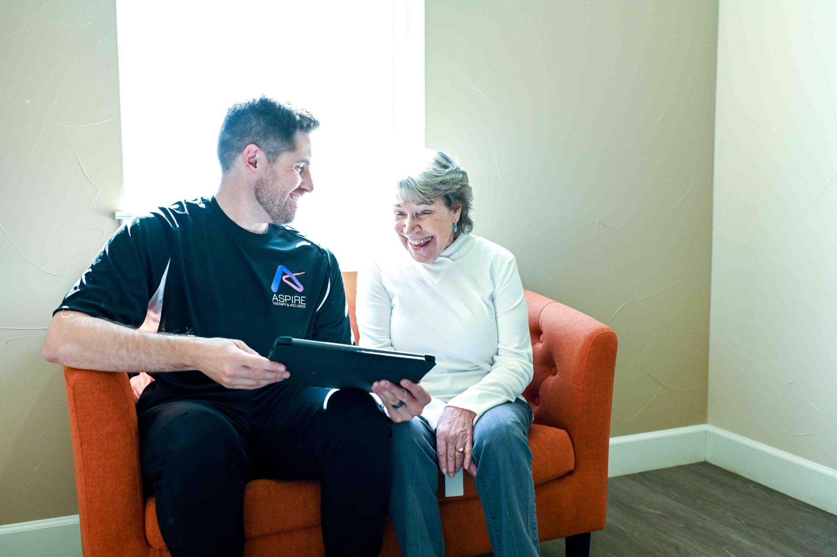
Physical Therapy Interventions - Education

Slide 29
That’s a lot of ground to cover!
What about the gaps between Patty’s needs and what PT can provide in a single session or entire plan of care?

Slide 30
Next Steps - Address need for Comprehensive Care
Referred out for OT and ST
  OT - difficulty with toilet transfers, shower transfers
  ST - voice and cognition (insight)
Relay Findings to Community Partner - A lot more going on under the surface!

Slide 31
Fall Prevention Journey
Systems of a Fall Prevention Program
Case Study
PT Fall Prevention Strategies
ST Fall Prevention Strategies
Notes:
ERIN TAKES THIS SLIDE

Slide 32
Case study:
ST
SLP Scope of Practice | Patty’s ST Evaluation | Fall + Safety Concerns
Fluency | WFL - no stuttering noted | May delay a resident from requesting help
Speech Production | WFL - no apraxia or word distortions noted | Reduced speech intelligibility may make it difficult for staff to understand the resident, could cause the resident hesitation to seek help
Expressive and Receptive Language | Functional conversational language; Difficulty with complex directions & higher-level word retrieval | May not understand safety directions or be able to communicate when she needs assistance
Cognition | MoCA: 17/30 = moderate impairment Deficits emerge with increased complexity | May forget to precautions (ie: spinal, AD), misjudge risk, difficulty problem solving
Voice + Resonance | Reduced vocal intensity | May be unable to effectively call for help
Feeding + Swallowing | Prolonged meals and decreased fluid intake - not diet change necessary, continue with regular solids / thin liquids | May contribute to dehydration, fatigue, and weakness
*Auditory Habilitation/ Rehabilitation | +Bilateral hearing aids, inconsistent use | May miss safety instructions, cues, or alarms
Notes:
word retrieval in high stress situations = more difficult, also impacts naming equipment or labels of staff
MoCA = 17/30 moderate impairment, she’s the type of resident you can have a completely normal conversation with —but when the cognitive demands increase, the deficits become much more apparent. She’s not recognizing unsafe situations 2* poor insight.
Can she recall the education PT/OT are providing?
Dysphagia = fatiguing self, decreased caloric intake = increased weakness = may need energy conservation

Slide 33
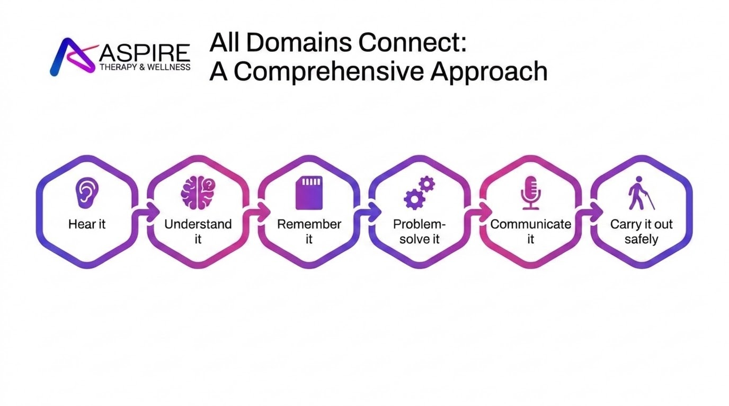
Notes:
***USE A SPECIFIC ADL***

Slide 34
Speech Therapy
Recommendations
Safety
Grab Attention
One Communication Partner
Communication Style
*Contact SLP for any changes in status*
Call light use
Keep AD nearby
Wear hearing aids
Visual reminders
Use “loud” voice
Face her
Reduce noise
Speak clearly
Short, one step directions
Use teach-back method
Allow processing time
Dysphagia Recommendations: offer smaller meals throughout the day; protein shakes, consult dietician

Slide 35
“Sundowning” + Fall Prevention
Nocturnal Delirium
Identify the sundown window (ie: starts around 5 pm)
Introduce exercise prior to bedtime = cortisol levels!
Maintain consistent bedtime routine and staff cues
Use simple one step directions and allow for extra processing time
Reinforce visual aids within environment
Increase lighting during waking periods
Reduce noise + distractions
Calm approach

Slide 36
Fall Prevention Journey
Systems of a Fall Prevention Program
OT Fall Prevention Strategies
Case Study
PT Fall Prevention Strategies
ST Fall Prevention Strategies

Slide 37
Occupational Therapy Findings
Activities of Daily Living (ADL) assessment
Patty was no longer showering due to difficulty with transfers, fear of falling, and difficulty with dressing –resorted to partial baths
She had low vision deficits interfering with her ability to navigate safely in her apartment
Increased urinary urgency – finding herself rushing to make it to the bathroom

Slide 38
OT Fall Prevention Interventions
ADL retraining – improve hygiene and reduce fall risk for showering + staff training
Transfer training with low vision environmental adaptations to reduce falls
Pelvic health strategies to reduce urgency and prevent falls with toileting
IDT collaboration with PT, ST, senior living community, and resident/family for more appropriate level of care (ALF)
  Patty remained in IL for another 6 months
Notes:
Bladder Strategies (just in case): avoid just in case urination; don’t wait hours to urinate after feeling the urge, don’t strain or push to urinate, toileting schedule/prompting, consider medications and estrogen, diet assessment (timing of caffein and heavily acidic foods stimulate urgency and frequency), strengthening around pelvis, breathing techniques

Slide 39
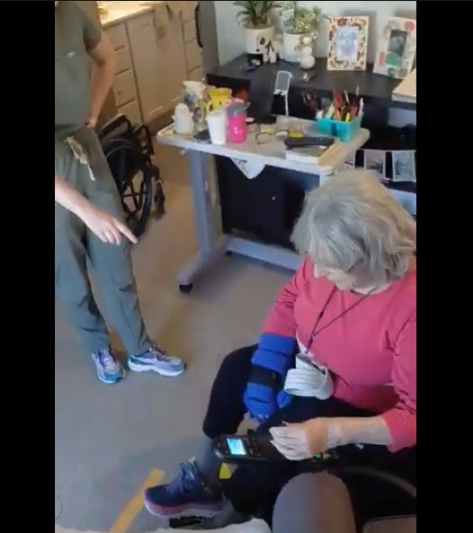

OT Collaboration with Community
Video for asynchronous staff training
External aids to promote carryover of strategies
Maximized independence of resident
Reduced caregiver burden
Safety recommendations using electric wheelchair
Short video with concise instructions/cuing
Notes:
Made video for AL staff to increase carryover of transfer strategies. We have tech to help us – let’s use it!

Slide 40
When to Refer to Therapy? Be proactive!
Early data collection - establish the trend
First move in
Home safety
Changes in status
  Physical ability
  Declining Hygiene
  Increasing Isolation/Reduced Socialization
  Increased Confusion
  New Swallow Issues
Notes:
Ben
New or worsening confusion or cognitive changes
Difficulty following directions or completing familiar routines
Increased forgetfulness or poor carryover of safety recommendations
Changes in judgment, problem solving, or safety awareness
Difficulty finding words or communicating needs
Speech becoming less clear or difficult to understand
Decreased vocal volume or difficulty being heard
Difficulty hearing or understanding staff, despite hearing aids
Changes in eating, drinking, or swallowing
Prolonged meals or decreased food/fluid intake
Any noticeable change from baseline affecting communication, cognition, or swallowing

Slide 41
Fall Prevention Journey
Systems of a Fall Prevention Program
OT Fall Prevention Strategies
Case Study
Q & A
PT Fall Prevention Strategies
ST Fall Prevention Strategies

Slide 42
Thank You!

Slide 43

Q A
&

